Slide 1
Application for
McKinney-Vento Homeless
GPS

Slide 2
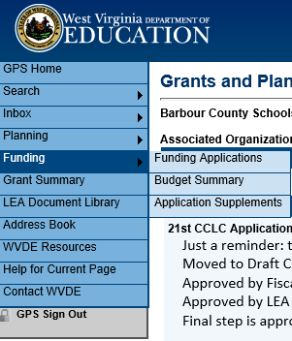
Application Supplements
Under Funding on the Blue Navigation Tab select Application Supplements

Slide 3
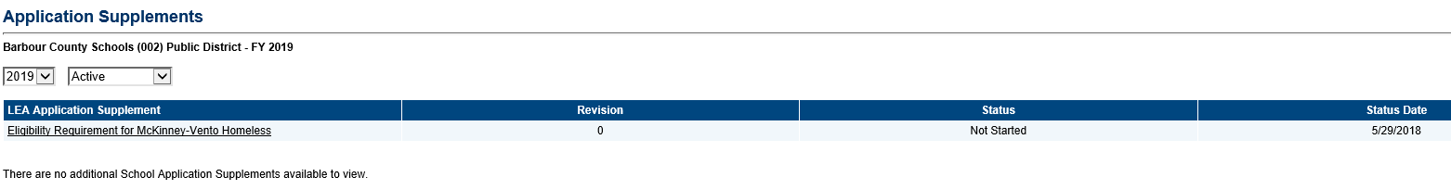
Eligibility Requirement for McKinney-Vento
Click on the Eligibility Requirement for McKinney-Vento Homeless in order to complete this part of the application process

Slide 4
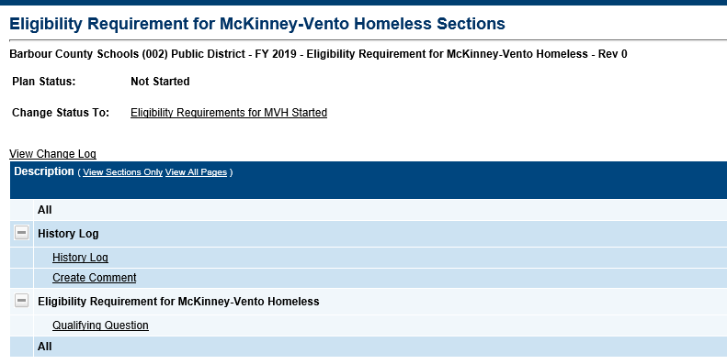
Eligibility Requirement for McKinney-Vento (Cont.)
The top of this page displays the Program name and number along with the fiscal year. It shows the current application status and the next step in the application process.
  Note: You must change the application status to Eligibility Requirements for MVH Started in order to be able to use all functionality of the application.

Slide 5
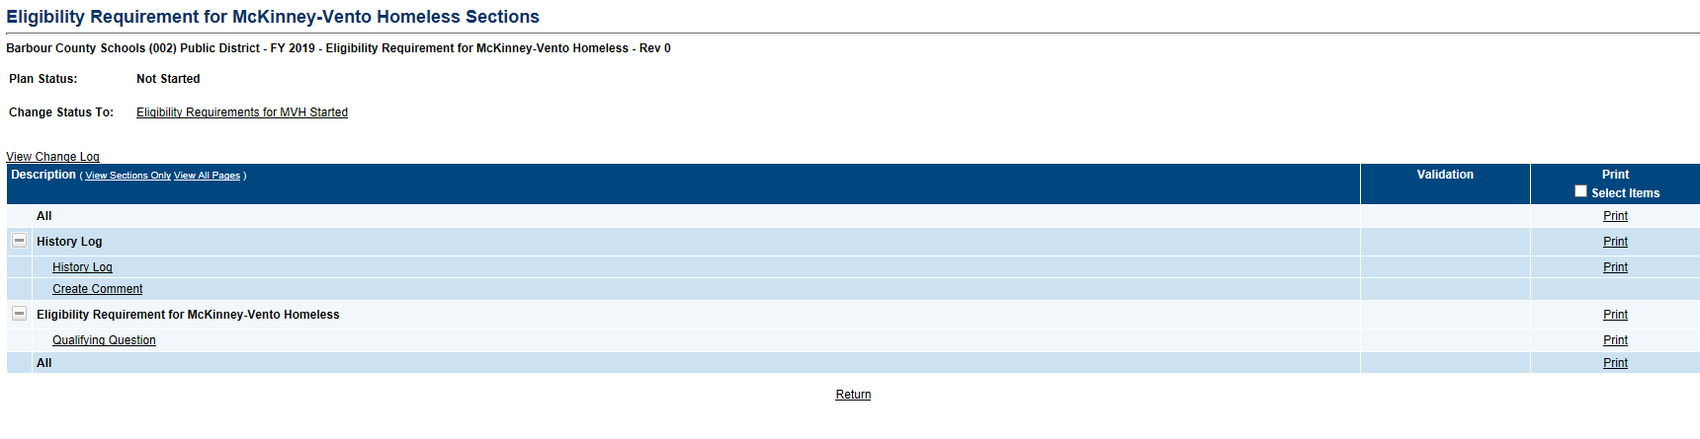
Eligibility Requirement for McKinney-Vento (Cont.)
On the Sections page you will see the following options:
  History Log – This will be a log of all status changes in this Eligibility Requirement for McKinney-Vento
  Create Comment – Option for leaving comments for other County individuals that will have access to this application or for WVDE users.
    Note: Once a comment has been created it cannot be edited or deleted.
  Qualifying Question – The Eligibility Question that needs to be answered before moving forward with the actual McKinney-Vento Application

Slide 6
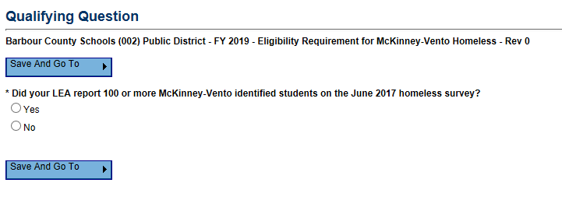
Eligibility Requirement for McKinney-Vento (Cont.)
After you have moved it to Eligibility Requirements for MVH Started you will need to click on Qualifying Question and answer the question and hit Save and Go To Sections Page.

Slide 7
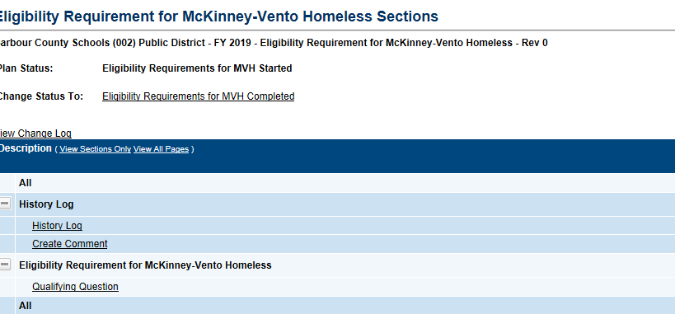
Submission of McKinney-Vento Eligibility Requirement
Once you have answered the question move the application to Eligibility Requirements for MVH Completed.

Slide 8
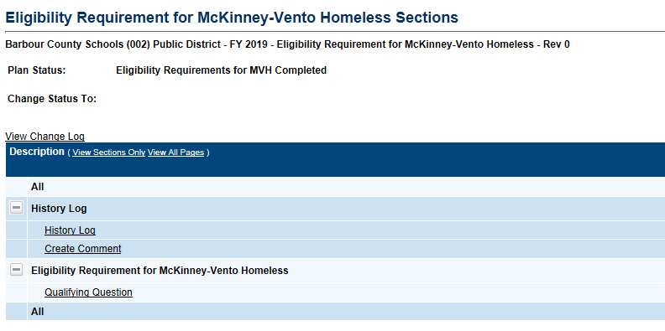
Submission of McKinney-Vento Eligibility Requirement
This is what your Status should show in order to know that this has been fully completed.

Slide 9
Submission of McKinney-Vento Eligibility Requirement
Once you have completed this step please give WVDE Office of Federal Programs up to 24 hours to open up the second part of the McKinney-Vento Homeless Application.
  Note: If you do not receive an email from WVDE Office of Federal Programs within 24 hours stating that the next part of the McKinney-Vento Homeless application is set up for you to complete, please send a quick email or call Elizabeth McCoy at eamccoy@k12.wv.us or 304-558-7805.
Currently there is not an automatic email from GPS to WVDE Office of Federal Programs to notify us of the completion of the McKinney-Vento Eligibility Requirement. We are working with our vendor to get that set up.
Once you have received that email from WVDE Office of Federal Programs please complete the following steps to complete the application and budget for the McKinney – Vento Homeless Funding.

Slide 11
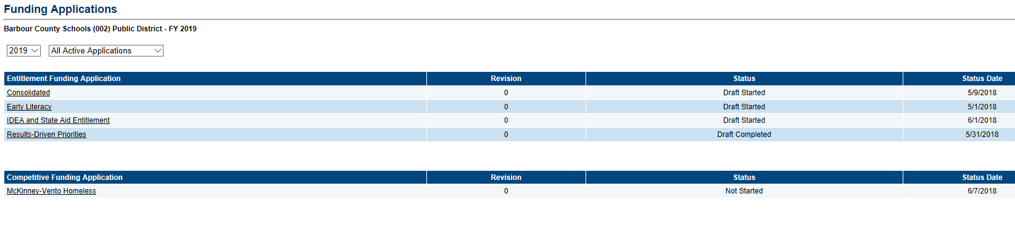
Funding Applications
Select Funding from the Navigation Options then select Funding Applications. This page is where you will select the year and the application you want to access.
Click on the application name under the Competitive Funding Application Heading.

Slide 12
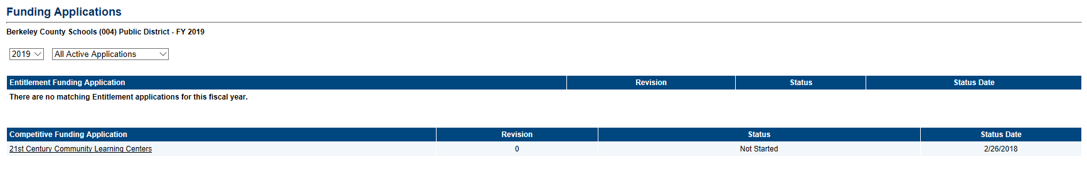
Funding Applications (Cont.)
This screen will show you all the grants available for your Program along with:
  Status Date
  Status
  Revision Number
You can also toggle back between fiscal years once there are multiple years of a specific grant in the system
4
3c
3b
3a

Slide 13
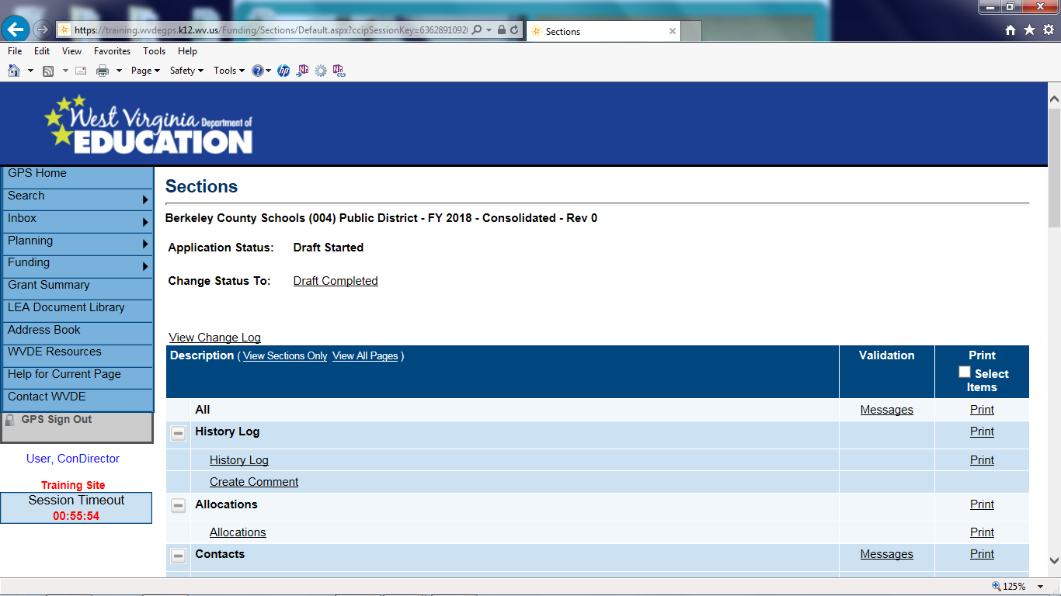
Sections Page
application or revision.
The top of this page displays the Program name and number along with the fiscal year. It shows the current application status and the next step in the application process.
  Note: You must change the application status to Draft Started in order to be able to use all functionality of the application.
View Change Log – allows a user to view all changes that have occurred within the original application or revision
1
2

Slide 14
Sections Page (Cont.)
In the Description Header you can choose to either have it display the section titles only or all pages.
The section titles are:
  History Log – Displays the history of comments and status changes within GPS. Also contains the ability to post comments and send emails within GPS.
  Allocations – Displays an overview of the allocations once they are awarded for the McKinney-Vento grant.
  Contacts – A listing of Program contacts for McKinney-Vento.
  McKinney-Vento Homeless Program Level – Application Pages
  McKinney-Vento Homeless application– Application Pages
  McKinney-Vento Homeless Checklist– Sectional review and rubric for McKinney-Vento Homeless Application.

Slide 15
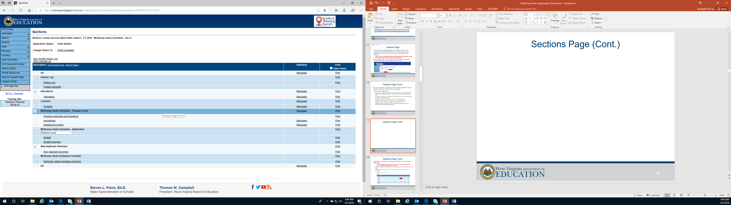
Sections Page (Cont.)

Slide 16
Sections Page (Cont.)
Validations – provides messages related to each section and page.
    Note: Messages display errors and warnings that must be addressed in order to successfully submit the application.
  Section messages will display errors and warnings for the selected section or page.
  All messages will display errors and warnings for all sections of the McKinney-Vento Application

Slide 17
Sections Page (Cont.)
Print– Select print next to each section in order to print that specific page in a PDF Format.
Print Select Items - Selecting the Print Select Items checkbox allows you to select multiple sections and pages to print in a PDF Format.
  Note: Pop up blocker must be turned off on your computer in order for the print pages to pop up for viewing.

Slide 18
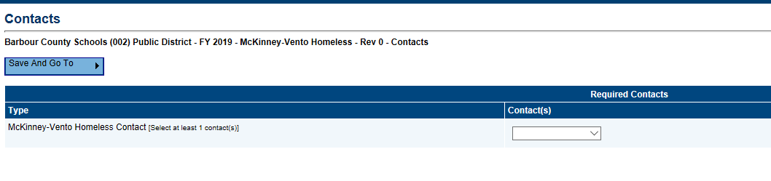
Contacts
This page contains a listing of Program contact(s) for McKinney-Vento Homeless
A contact is required for the McKinney-Vento Homeless Application.
  Note: if a contact is not selected it will result in an error which will prevent the application from being ready to submit.
The drop down will display the available users for your Program.
  Note: If any of the contact names are not showing up please contact WVDE utilizing the Contact WVDE Page (http://wvde.state.wv.us/forms/federal-programs/gps-help/ ).

Slide 19
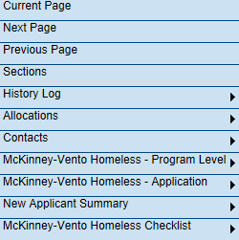
Save and Go To
To get access to another page or section in the McKinney-Vento Homeless Application and to save the progress you have made on your current page please select the Save and Go To button at the top or bottom of every page.
Options under Save and Go To:
  Current Page
  Next Page
  Previous Page
  Sections
  History Log
  Allocations
  Contacts
  McKinney-Vento Homeless– Program Level
  McKinney-Vento Homeless– Application
  McKinney-Vento Homeless - Checklist

Slide 20
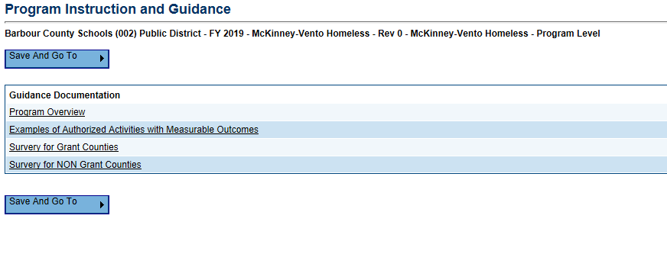
Program Instruction and Guidance
The Program Instruction and Guidance page has some guidance documents and instructions for the McKinney-Vento Homeless Application.

Slide 21
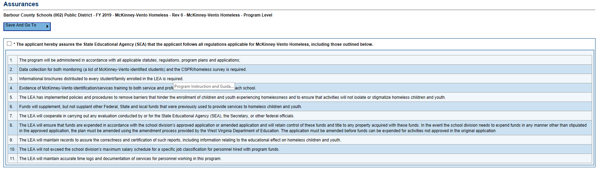
Assurances
Please read through these assurances and then mark the box at the top that you will follow the regulations.

Slide 22
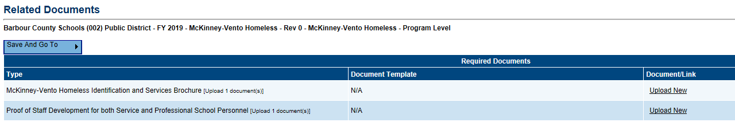
Related Documents
  There are 2 Required Related Documents that must be uploaded.
    Note: If these documents are not uploaded you will not be able to submit your application
  The documents are:
    McKinney-Vento Homeless Identification and Services Brochure
    Proof of Staff Development for both Service and Professional School Personnel

Slide 23
McKinney-Vento Homeless Application
Back on the Sections page under the McKinney-Vento Homeless Application Section is a drop box that will need to be completed in order to pull up the rest of the application for McKinney-Vento Homeless funding.
  Note: The District Level Budget is not editable it is only there as a reference to show what has been budgeted at the application levels.
Select the drop down box and then select Add Grant Application

Slide 24
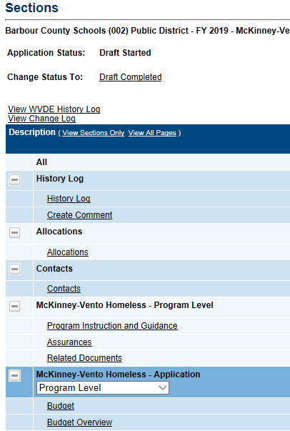
McKinney-Vento Homeless Application (Cont.)

Slide 25
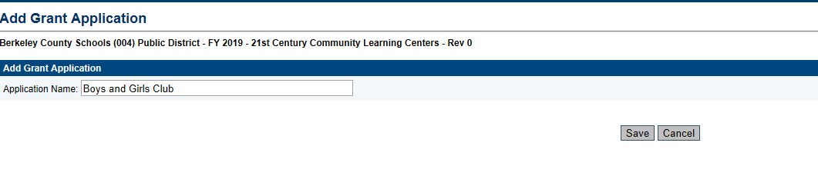
McKinney-Vento Homeless Application (Cont.)
After you have selected Add Grant Application you will then fill out the Application Name and hit the Save button

Slide 26
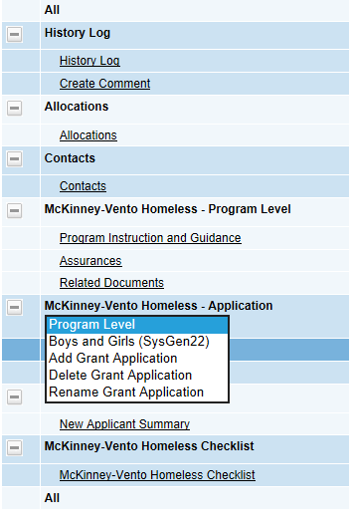
McKinney-Vento Homeless Application (Cont.)
Once you hit save it will return you to the Sections Page and you will see the Application name you just typed in under the drop down box.
  Note: Complete these steps for each different Application you will be completing.

Slide 27
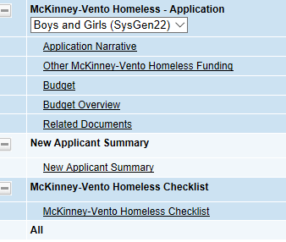
McKinney-Vento Homeless Application (Cont.)
Select the Application you want to complete, once you do this you will see other options showing up under that application name to be filled out and completed.

Slide 28
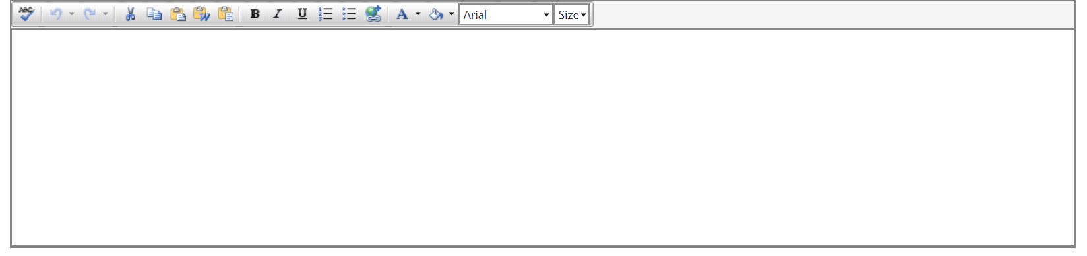
Application Narrative
The following narrative boxes must be completed:
a.
Specific Needs
b.
Program Overview
c.
Program Administration and Management

Slide 29
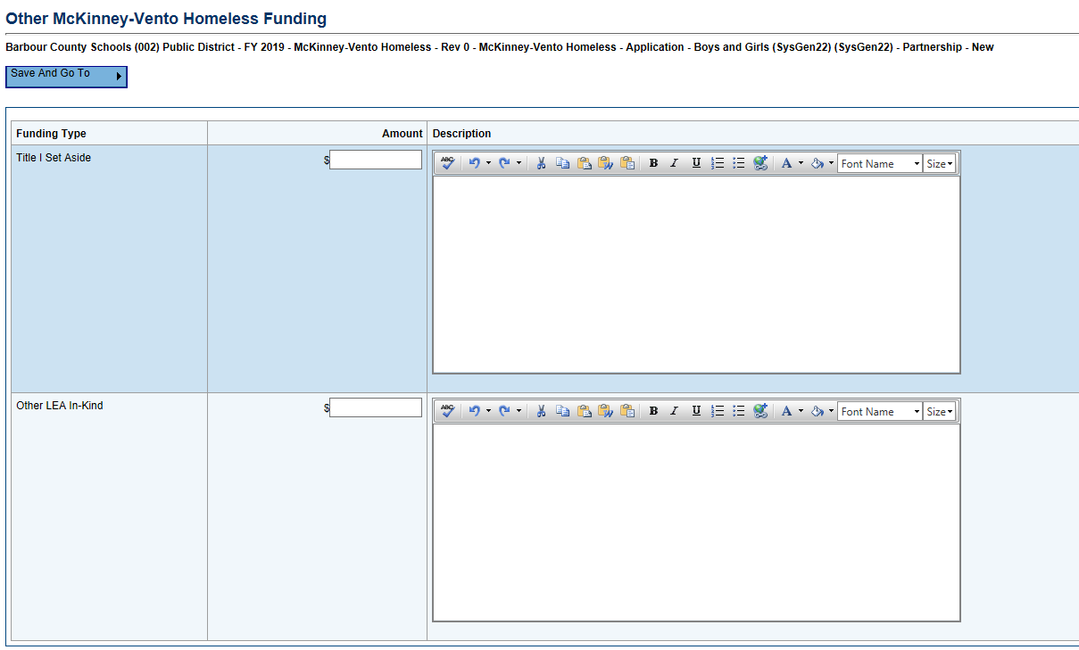
McKinney-Vento Homeless Funding
Please complete the table with any other McKinney-Vento Homeless Funding that will be used.

Slide 30
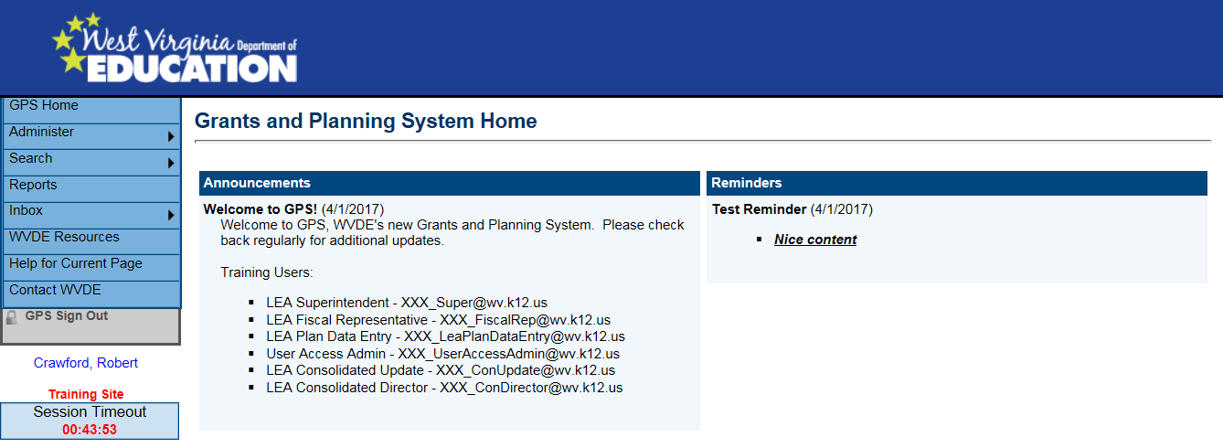
Budget
Note: Budgets are required to be input at the function and object code level. Information regarding function and object codes can be found in the Chart of Accounts Manual located under WVDE Resources.

Slide 31
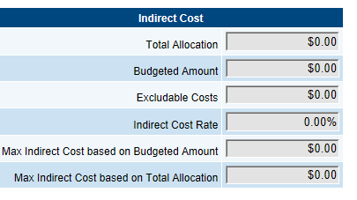
Budget (Cont.)
Indirect Cost Guide is a view only table that includes:
  Total Allocation
  Budgeted Amount
  Excludable Costs
  Indirect Cost Rate
    Approved indirect cost rate for Program
  Max Indirect Cost on Budgeted Amount
    Max amount that can be budgeted for the Program
  Max Indirect Cost based on Total Allocation
    Max amount to be budgeted for indirect cost

Slide 32
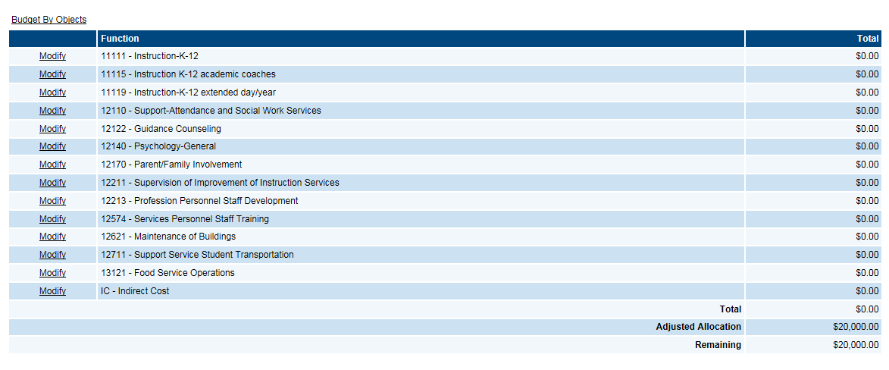
Budget (Cont.)
Budget Sheet can be viewed in two different formats.
  Budget by Function Code
    The default view is budget by Function Code
  Budget by Object Code
    To change the view to Object Code click on the Budget by Objects link

Slide 33
Budget (Cont.)
Enter in a line item by clicking the Modify button next to the Function or Object Code.

Slide 34
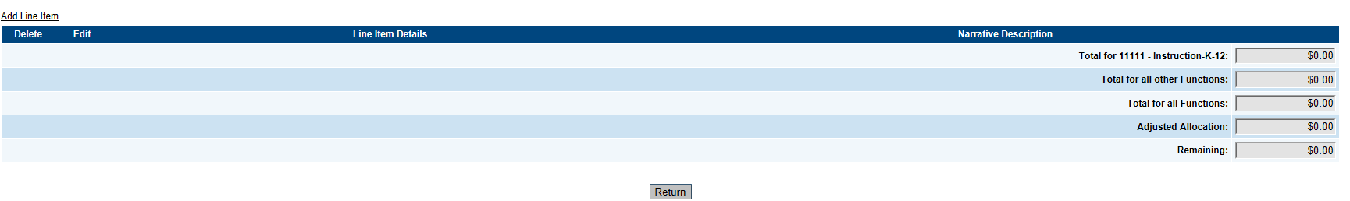
Budget (Cont.)
Under each Function Code or Object Code is a View Only table that calculates what is already budgeted for that particular Function/Object Code along with what is budgeted for other Function/Object Codes. It will also calculate the total and the remaining amount.
To add in a line item for a particular Function / Object code click the Add Item link.

Slide 35
Budget (Cont.)
When in the Function Code view you will select the object code (if you are in the Object Code view you will then select the Function code from the Drop down box) from the drop down box that corresponds with the specific budget item.
Enter in the Quantity of the object that is being budgeted.
Enter in the unit cost for the line item in the Cost column
Line Item Total is a view only box that will multiply the unit cost by the quantity entered for the particular line item.
Provide a narrative description for how the Program is going to utilize the budgeted funds.
  Note: if any of these fields are left empty it will result in an error and will not allow the application to be submitted.
Press Save or Save and Return to save the information that has been entered for that line item.

Slide 36
Budget Overview
Budget Overview is a view only page that displays the totals for each budgeted line item.
Indirect Cost Guide is a view only table that includes:
  Total Allocation
  Existing Budget in Categories not Eligible for Indirect Cost
    Any portion of your allocation used for object codes that are not eligible for indirect cost
  Total Available for Budgeting in Categories Eligible for Indirect Cost and Indirect Cost
  Indirect Cost Rate
    Approved indirect cost rate for Program
  Max Available Budget in Categories Eligible for Indirect Cost
    Max amount that can be budgeted for the Program
  Max Indirect Cost
    Max amount to be budgeted for indirect cost

Slide 37
Submission Process
Once the application is complete the McKinney-Vento Homeless Director will need to move the application into Draft Completed status at the top of the Sections Page.
Once the Director marks it complete it will go to the Fiscal Representative for approval.
The next step is for Superintendent or Agency Head approval.
Once the Superintendent or Agency Head approves the application it will come to WVDE Office of Federal Programs for final approval for funding.

Slide 38

Questions?

