Slide 1
Purposeful Planning for Student Success
Notes:
Set the stage for the day.
Review packet materials.
Explain purpose/outcomes for the day.

Slide 2

Planning for Continuous Improvement
Guided Conversations
PLAN
Why: Why do we need a Strategic Plan?
Who: Who should be involved in the process?
How: How does the plan reflect the data and data analysis?
How does the plan inform job embedded practices to support
student achievement?
How do we select appropriate strategies and activities to
accomplish the goals in the plan?
What: What monitoring systems will need to be in place?
When: When will we review plan implementation progress?

Slide 3
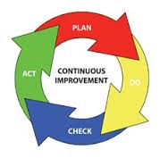
Continuous Improvement
Notes:
Our strategic planning process is guided by the WV Standards for Effective Schools.

Slide 4
WV Strategic Planning Focus
Reading
Skills
Math
Skills
Chronic Absences

Slide 5
Accountability Indicators
Elementary/Middle School Indicators
High School Indicators
Academic Achievement
- ELA Proficiency
- math Proficiency
Academic Progress
- School ELA Progress
- School Math Progress
English Language Proficiency
Student Success
- Attendance
- Behavior
Academic Achievement
- ELA Performance
- Math Performance
Graduation Rate
- 4 Year Cohort
- 5 Year Cohort
English Language Proficiency
Student Success
- Attendance
- On-Track to Graduation
- Post-Secondary Achievement

Slide 6
Plan Submission Process
Schools develop and submit their strategic plans to the district
District reviews the school plans and identifies the needs across the district
District reviews and analyzes the LEA data then develops and submits the LEA strategic plan
District completes the Consolidated Application, develops the budget, then submits the application to the WVDE
Notes:
Clear guidance provided by USDE within ESSA that District plans be informed by the needs identified across the district’s schools.

Slide 7
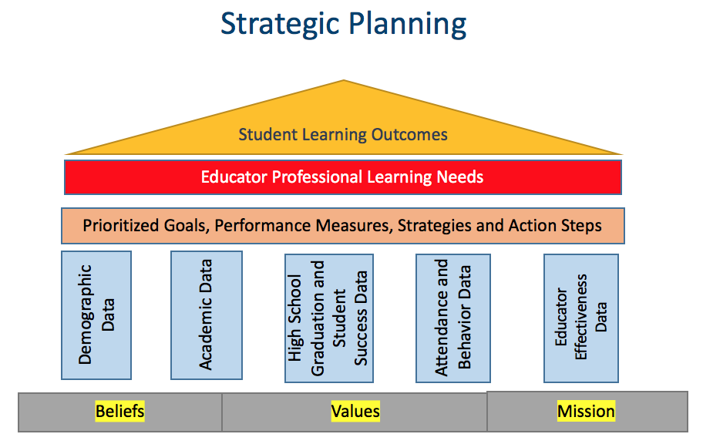
WV Strategic Plan
Planning Process
Comprehensive Support and Improvement & Targeted Support and Improvement Plans
Needs Assessment
Goals
Performance Measures
Progress Notes
Strategies
Action Steps
ESEA Components: District/Title I Schoolwide/TAS
GPS Houses the Plan
Notes:
ESEA Components are also ref

Slide 8
Highly Recommended…
Draft in a digital template* before entering into GPS
Comprehensive Needs Assessment
Goals
Performance Measure(s)—related to Goals
Strategies
Action Steps
*Sample templates are available on GPS, under WVDE resources.
Notes:
-Develop the draft of the plan before entering it into GPS
-Review the draft plan with staff, student leadership, LSIC, etc.
-Make final edits to the draft plan then enter the plan into the GPS platform. (Note: Designated individuals can be given Plan entry level access to the GPS plan. Contact your district superintendent’s office to obtain access. The GPS login is accessible with your Office 365 credentials.); Work with district leadership to work in conjunction with district focus areas/initiatives.
-Decide a progress monitoring timeline to review the plan (ex. Monthly, bi-monthly, each semester, etc.)
--input progress notes/data reviews into narrative (maintain as a diary)
--tweak/update goals and action steps as needed
-Use this progress information to guide next years plan
District level leadership (Prior to developing the district strategic plan)
--review and analyze district-wide needs assessment data
--review all school strategic plans
--look for commonalities, trends, areas of concern, and urgency
--then develop the district strategic plan (This would require schools to submit their completed strategic plans, for district review, prior to the development of a district plan.)

Slide 9
Conduct SWOT analysis of current strategic plan
Review current plan data sources/results, goals, strategies, actions steps, and progress notes
What are the…
S—Strengths in current plan
W—Weaknesses observed in the plan
O—Opportunities available to strengthen the plan
T—Threats which may hinder the plan outcomes
SWOT is optional
Notes:
Activity can be conducted with whole staff divided into small groups (45-60 minutes)
Provide data analysis results/needs assessment data and/or progress notes for each group (Data posters are also beneficial)
DIRECTIONS FOR CONDUCTING THE SWOT ANALYSIS
A SWOT analysis is a simple tool to help you work out the internal and external factors affecting your business. It is one of the most commonly used business analysis and decision-making tools. A SWOT analysis helps you:
•build on strengths (S)
•minimize weakness (W)
•seize opportunities (O)
•counteract threats (T).
To get the most out of a SWOT analysis, you need to conduct it with a particular objective in mind. For example, a SWOT analysis can help you decide if you should introduce something new or change your processes.
A SWOT analysis is often part of strategic planning. It can help you better understand your organization and work out what areas need improving.
STEP 1: Decide on the objective of your SWOT analysis
STEP 2: Strengths
Identify and list what you think are your strategic plan strengths. Examples could include strengths relating to SMART goals, data sources, and appropriate action steps directly related to the goal.
STEP 3: Weaknesses
List things in your strategic plan that you consider weaknesses. Weaknesses could include poorly written goals, redundant action steps, non-measurable goals, limited or no data sources, excessive actions steps, responsibilities unclear, non-focus on school’s needs assessment(s).
STEP 4: Opportunities
Think about the possible external opportunities for your school’s plan to be successful. These are not the same as your internal strengths. For the SWOT analysis, the same item would not be as both an opportunity and a threat. Opportunities could include new technology, training programs, partnerships, grants, stakeholder communication.
STEP 5: Threats
List factors, which were a threat or cause a problem for the successful implementation of your school’s plan. Examples of threats could include employee cuts, program cuts, funding sources, school culture and climate, lack of community support, employee turnover.
Establish priorities from the SWOT
When you have completed the steps above, you will have four separate lists. Ideally, these lists can be displayed side-by-side so you can have an overall picture of how your strategic plan is running and what issues you need to address (i.e. develop four prioritized lists). Along with your school The results of your SWOT will greatly assist with developing your school’s next strategic plan.
Adapted from: https://www.business.qld.gov.au/business/starting/market-customer-research/swot-analysis/conducting-swot-analysis

Slide 10
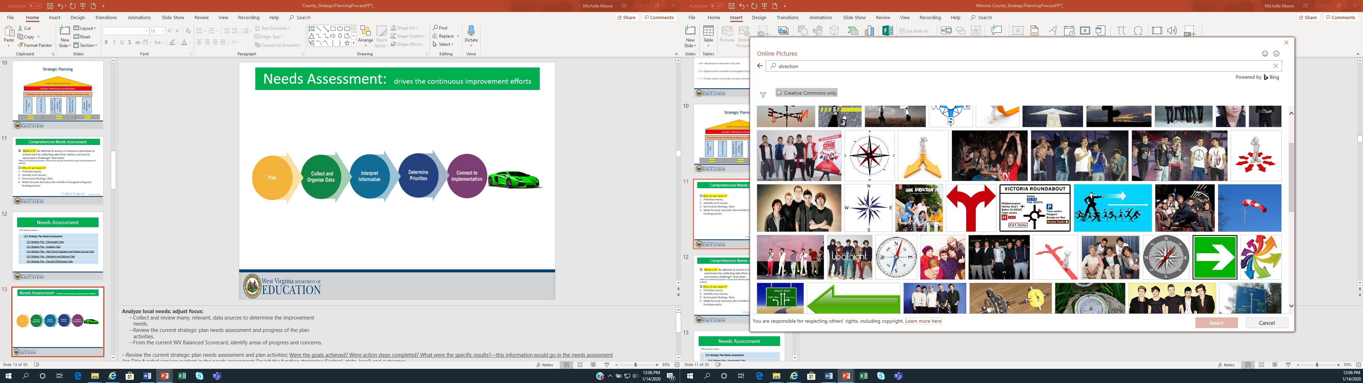
Comprehensive Needs Assessment
What is it? An attempt to assess or measure a perceived or actual need by collecting data (from various sources) to document a challenge* that exists
*Note: For LEA/School purposes—Factors that have the potential to impact the achievement of students.
Student Learning Outcomes
Educator Professional Learning Needs
Prioritized Goals, Performance Measures, Strategies and Action Steps
Planning begins here!
Demographic Data
Academic Data
High School Graduation and Student Success Data
Attendance and Behavior Data
Educator Effectiveness Data
Beliefs
Values
Mission
ESSA Section 1114
Notes:
See Examples of Additional Data Sources document, located on the GPS platform under WVDE resources.
Data sources also include results from practices, strategies, and interventions provided…Remember to maintain data on funding activities, such as support staffing with Title funding, purchased programs, and resources; blended funding activities, and state/local initiatives.

Slide 11
Comprehensive Needs Assessment
It’s Best Practice!
Why do we need it?
Prioritize needs,
Identify root causes,
Summarize findings,
Make focused decisions (be mindful of programming and funding needs), then
Evaluate whether these strategies are addressing improvement needs/achieving desired results
ESSA Section 1114

Slide 12
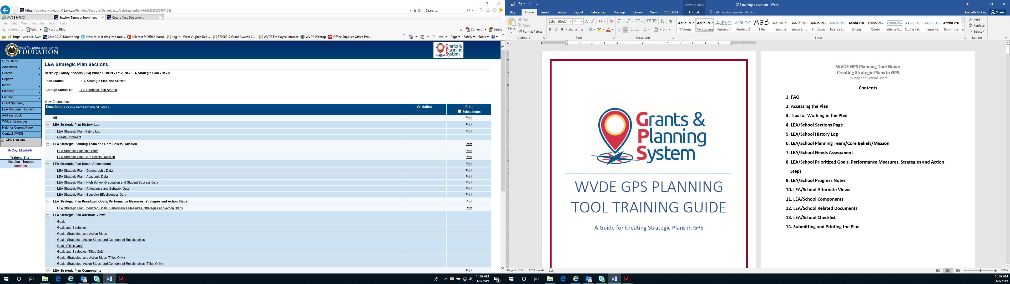
Comprehensive Needs Assessment
GPS Sections Screen
Group Activity
Notes:
Screen shot from the GPS platform. Each section of the needs assessment has prepopulated data charts. There are also rich text boxes to identify local data sources/results, write a detailed summary of the root cause analysis and funding connections. The prepopulated data charts are not the only data that should be considered by a district or school for each section of the needs assessment. The district/school is strongly encouraged to use various data sources to identify strengths and weaknesses, in order to get a thorough picture of performance, obstacles, and priority needs.
Group activity is either the carousel activity (small groups brainstorm examples of relevant, local data sources) or individual activity using the example data sheet to highlight data sources relevant to their current plan and additional sources to provide clearer pictures of their root causes.

Slide 13
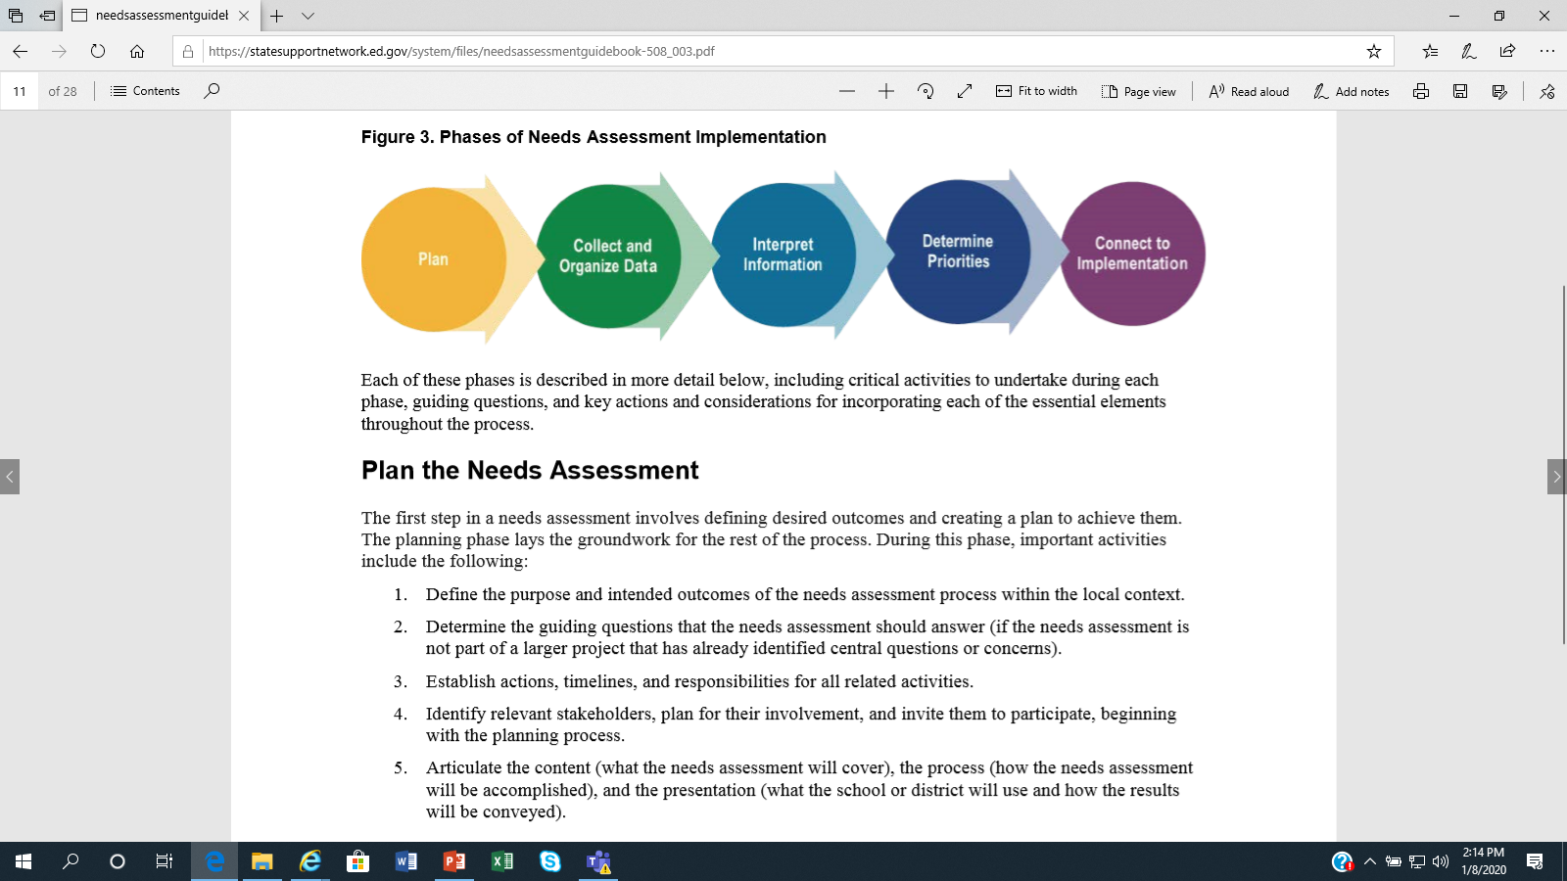
Comprehensive Needs Assessment
What is the framework? Who will be involved?
What various forms of data will be collected? How will it be organized and presented?
Why does the data look the way that it does (root cause)?
How will the focus be narrowed into a manageable, key set of priorities?
What evidence-based strategies/
interventions will support long-term change?
State Support Network, Needs Assessment Guidebook, pg. 8, May 2018
Notes:
See handout for program funding expectations for each Title program. Address these in the needs assessment. The needs assessment will drive the strategic (schoolwide) plan goals, strategies, and action steps.
Source: Southwest Comprehensive Center at WestEd, April 2008
1) Plan:
--What is the framework of the needs assessment? Demographics, Academics (ELA, Math, ELs), High School/Student Success, Attendance/Behavior, Educator Effectiveness; What do we need to know or understand about each of these topics (instruction, assessment, achievement, climate, etc.)
--Who are the key stakeholders who need to be engaged and at what points in the process? Different stakeholders may be engaged at different levels during the process; be intentional and transparent regarding communication
--Establish actions, timelines, and responsibilities for all related activities
2) Collect and Organize Data:
--Needs to be readable and useful for stakeholders.
--Collect and review various forms of relevant data sources; organized and presented for interpretation (See Examples of Additional Data Sources handout); The current strategic plan progress is a data consideration as well as the current WV Balanced Scorecard.
--Identify comparisons within the data sets.
--Disaggregate data wherever possible to help identify areas of need that may not be apparent: (demographics, exceptional students—which includes low-achieving students, students with additional needs—students in foster care, homeless, migratory, English language learners, etc.).
--Aggregate observation data by grade level or grade band and perception data by stakeholder group.
--Include longitudinal data (when possible) to aid in identifying any trends over time.
--Create visuals (charts, tables, graphs) to help understand the information presented; display data in formats that are easy to interpret and analyze.
3) Interpret Information:
--Root causes: Examine the relevant data and create meaningful determinations about what is revealed from the data. (Why does the data look the way that it does?); examples… adjustments to teacher instruction or supports for improving attendance, etc.
4) Determine Priorities:
--Multiple needs or issues may emerge…it is important to narrow this list to a key set of priorities that are manageable.
Various tools are available online to assist with determining priorities.
Simple approaches—rank ordering the needs without any particular formal procedure
Multiple criteria approach—for more complex needs that are judged against criteria that address importance and feasibility
Risk assessment—done by examination of the needs relative to the risk of not addressing them
--Address the strategies and resources (especially federal, state, local funded)that have been implemented and reflected in the data. (What’s working or not working and why?);
5) Connect with Implementation:
--Identify, examine, and select appropriate strategies and evidence-based interventions for implementation that will support long-term change.
--Revisit the strategic plan to make adjustments, based on the identified needs; develop goals, implementation strategies, and activities (action steps) to support the needs.
Source: State Support Network: Partnering for School Improvement, Needs Assessment Guidebook, Cary Cuiccio & Marie Husby-Slater, May 2018.
Remember: The consolidated funding application and strategic plan activities must tie back to the comprehensive needs assessment.

Slide 14
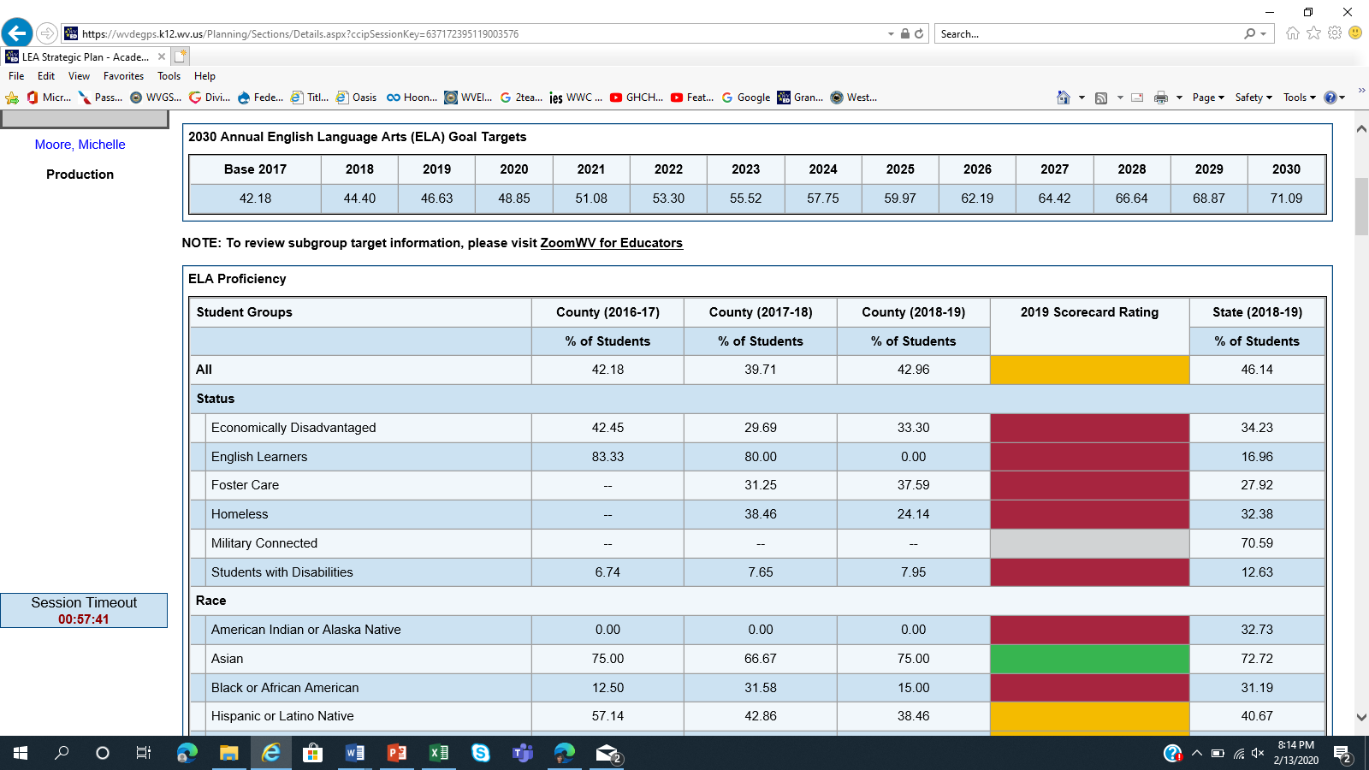
Pre-populated data tables

Slide 15
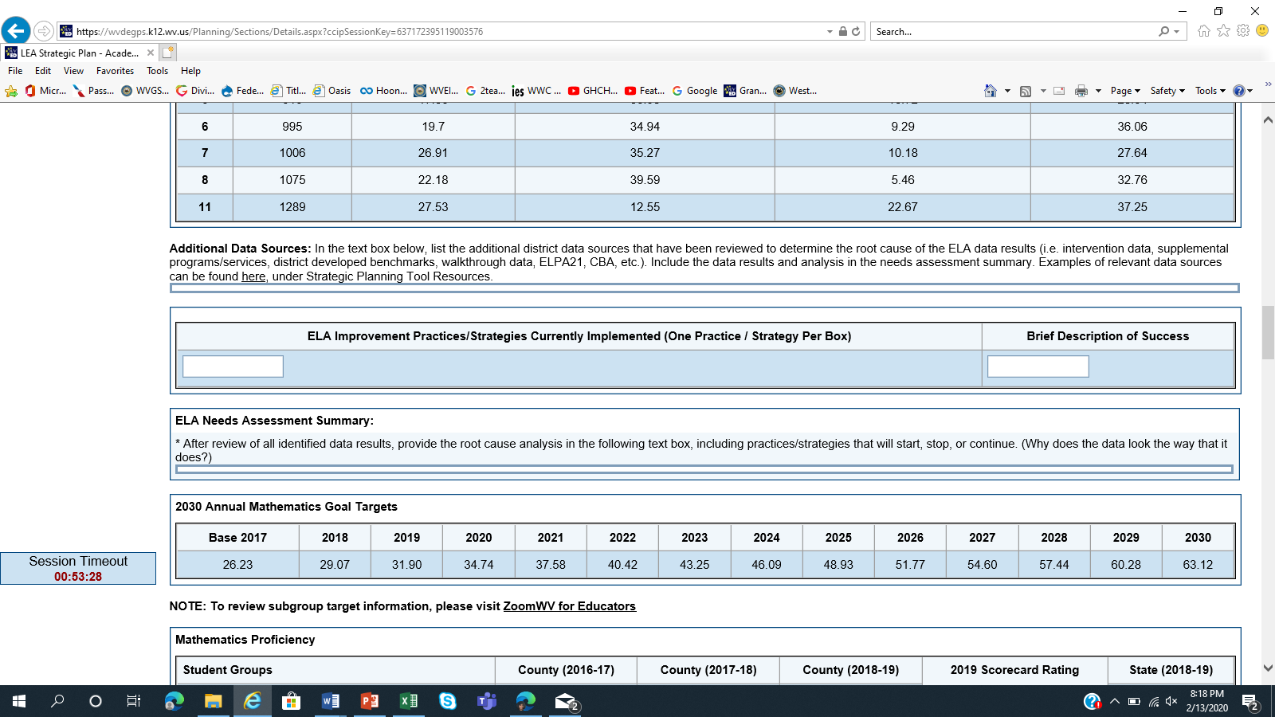
Needs Assessment Summary

Slide 16
Available, online, resources for evidence-based interventions:
What Works Clearing House https://ies.ed.gov/ncee/wwc/
-- includes various, available programs and shows the evidence of effectiveness
State Support Network https://tinyurl.com/SI-evidencebased
-- leveraging evidence-based practices for local school improvement
Blueprints For Healthy Youth Development https://www.blueprintsprograms.org/
-- a national violence prevention initiative to identify programs that are effective in reducing adolescent violent crime, aggression, delinquency, and substance abuse.
Notes:
From the results of the comprehensive needs assessment, we can now build our strategic plan goals, performance measures, strategies, and action steps to support our prioritized focus to improve student outcomes. The strategic plan activities connect back to the needs assessment.

Slide 17
Attendance Data Sources
Example
Zoom (including groups/cohorts)
Intervention & Incentive Activities
Student conferences/Parent conferences
SAT referrals/interventions
Walkthrough Data
Additional?
What does the data tell you? Why does the data look the way that it does (root cause)?

Slide 18
Area of Improvement for the Strategic Plan
Example
Look at attendance data and needs assessment to determine how many students were chronically absent.
Example:
During the 2019-2020 school year, 30% of students were absent 10 or more days during a one semester period.

Slide 19
Goal: measurable, focus area of improvement
Example
Goal title: Decrease Chronic Absences
Goal description: By January 2021, less than ___% of our students will be chronically absent.
Performance Measure: data collection methods
Example: Zoom data (including groups/cohorts), intervention progress data, incentive participation, conference logs (student and/or parent), SAT referrals/interventions, student engagement, walkthrough data
Updated GPS Change: No description required just a title related to what measure(s)/tool is being used.
Notes:
Go to the GPS platform, WVDE resources to find a document of examples for district and school goals, action steps, and strategies (Title and Non-Title).
Goal Statement - Broad statement as an academic goal or a behavior goal focused on a content area(s) (Academic Goal) OR building-wide initiative(s) i.e. structures, processes, procedures (Behavior Goal)
SMART Measurable Goal Statement
- Specific
- Measurable
- Attainable
- Result oriented
- Time bound
What will happen, with whom, by when, as measure by what?
Performance Measures: How will progress be measured? Data collection methods

Slide 20
Strategy: plan of action; techniques or methods
Example
Example: Tier 1--School-wide reinforcement program that includes focus on improved attendance.
Updated GPS Change: include title only, no description required
Action Steps: implementation of the strategy
Example: Develop school-based attendance program: purpose, structure, student recognitions, implementation calendar, and communication (staff, parents, students, and community members).
Updated GPS Change: No description necessary, just clear title
Notes:
Strategies: techniques, methods used to obtain a specific result or to move towards meeting goals

Slide 21
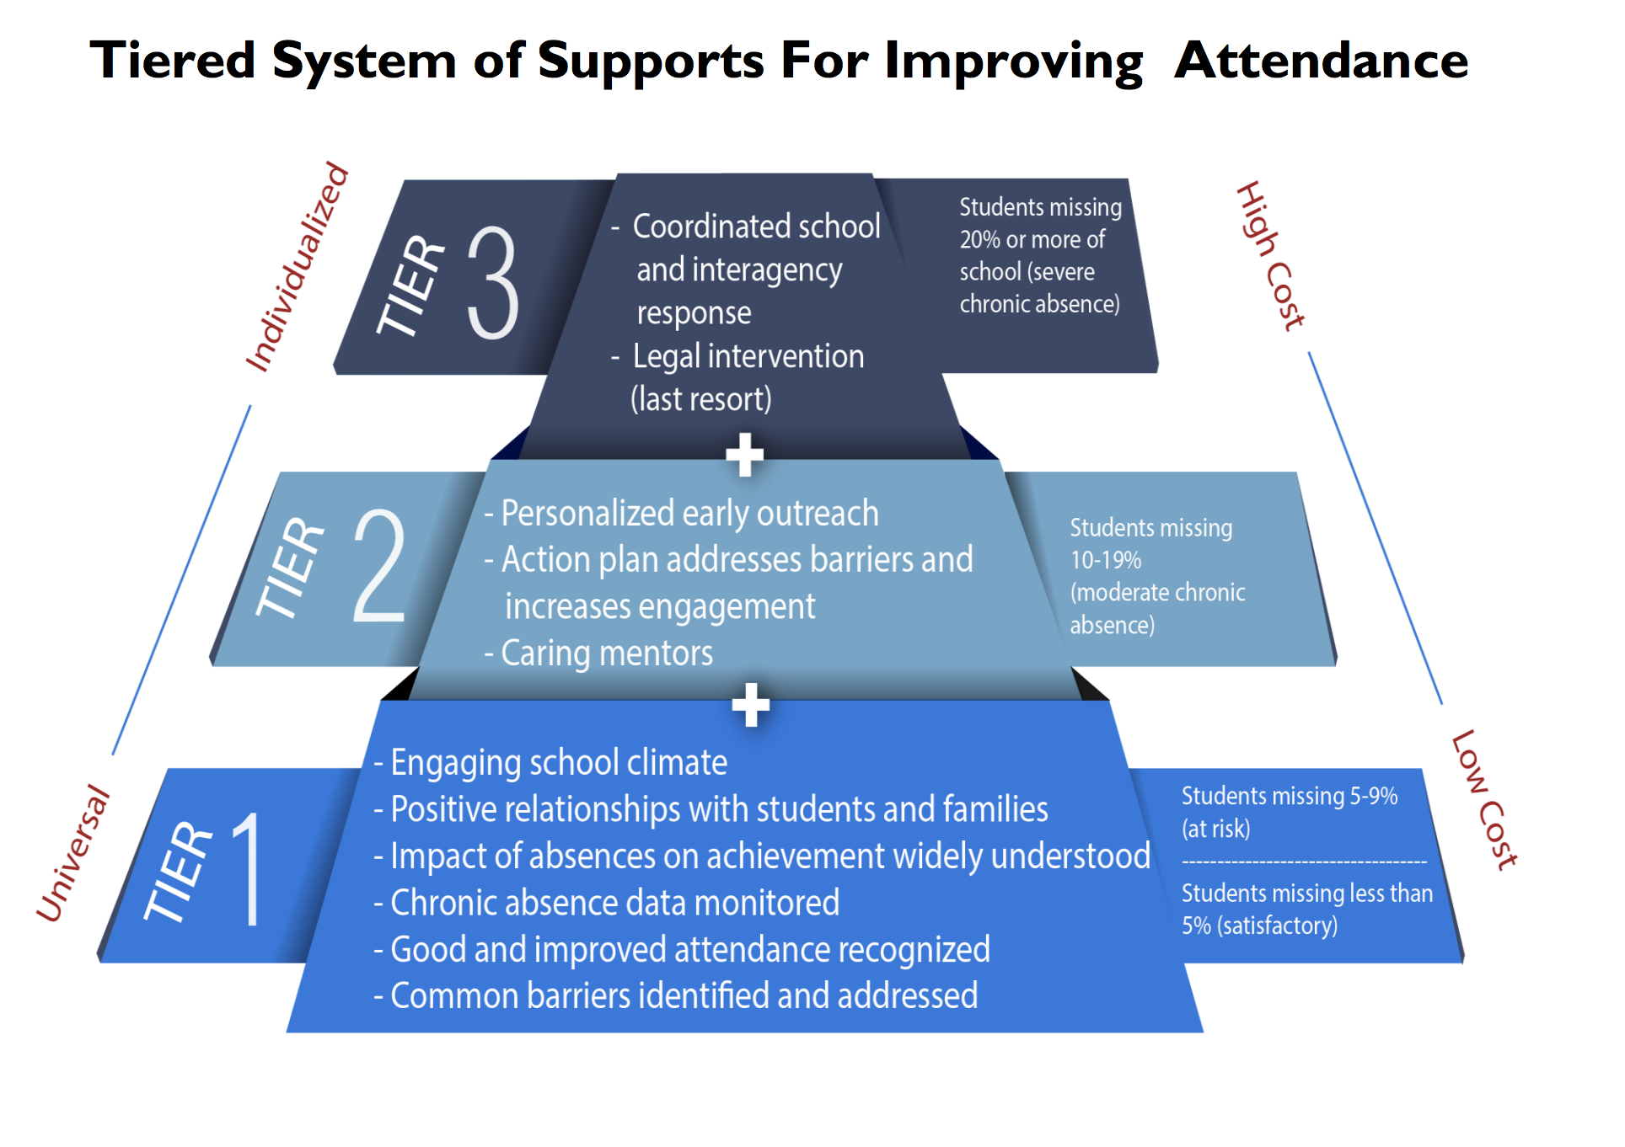
Attendance Goal Strategies
Create action steps to address each tier:
Tier 1- Universal strategies
Tier 2- Targeted, moderate chronic absences
Tier 3- Targeted, severe chronic absence

Slide 22
Tier 1- Universal Strategies
Action Step Considerations:
School-wide reinforcement program that includes focus on improved attendance
Community awareness
Communication strategies
Planning engaging activities before break

Slide 23
Tier 2- Targeted Strategies for Moderate Chronic Absence
Action Step Considerations:
Build personalized relationships with students and families who are at-risk
Mentors
Personalized student plans
Identify barriers
Provide professional development on working with at-risk students and their families

Slide 24
Tier 3- Targeted Intervention for Severe Chronic Absence
Action Step Considerations:
Use Early Warning System to identify students and develop targeted supports based on student needs
Refer to social worker and provide interventions
Convene periodic, case-management conferences with all relevant stakeholders

Slide 25
Action Steps
Be specific about what activities will occur.
Decide who will be the person(s) responsible for monitoring the action step(s).
Determine what process and data will be used to monitor the effectiveness of each action step.

Slide 26
‘Component Relationships’ are marked at the Strategy level in GPS
ESEA Components--required for the LEA Consolidated Plan, Title I Schoolwide, and Title I TAS
> Additional explanations may be entered into the platform in order to meet the requirement
WVSIPP--LEA requirement (Professional Development Plan)
> Marked component relationships will connect to the WVSIPP in GPS
Early Literacy--LEA requirement
>Marked component relationships will connect to the funding application
The ‘Funding connections’ to the LEA Consolidated Application are created at the Action Step level in GPS
District (LEA)-- All Title funding, IDEA, Early Literacy, etc.
Title I Schools, only-- Title I Part A & Title II Part A
Reminder: All plan activities and funding are to be justified through the comprehensive needs assessment
Notes:
IDEA, Math4life component relationships are also available

Slide 27

Example: School Strategic Plan Checklist

Slide 28


You’ve planned, now what?
Work the plan!

Slide 29

Monitor, often
Once the plan has been approved, move the status to ‘Progress Monitoring’.
Prior to plan implementation, schedule consistent times to review and update the plan (bi-monthly, each grade period, three times per year, etc.).
Determine who is responsible for gathering progress data and method of reviewing/presenting it to the team. Consider creating a data dashboard.
Notes:
Explain a data dashboard
“Monitor and adjust, monitor and adjust” Lezotte and Synder, What Effective Schools Do

Slide 30

Monitor, often
During the review meeting:
Assess and discuss how well the strategies and action steps are being implemented. What impact is evident?
Examine the outcomes to determine the extent to which the strategies helped achieve the set goals. Why does the data look the way it does?
Document the results, root cause analysis, and any adjustments that are needed.

Slide 31
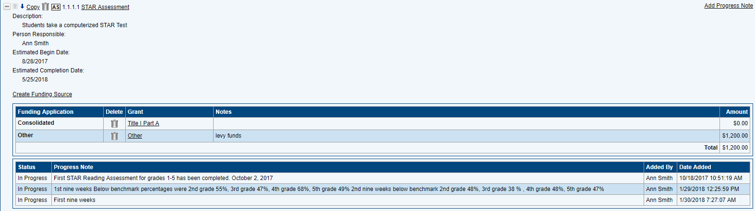
Progress Notes within the System
Notes:
Once the strategic plan has been developed, typed into GPS, and approved, it can be moved into ‘Monitoring Status’. Any plan, whether it’s a lesson plan, 30-60-90 day plan, or strategic plan is only as effective as the monitoring that occurs.
Refer to Progress Notes example.

Slide 32
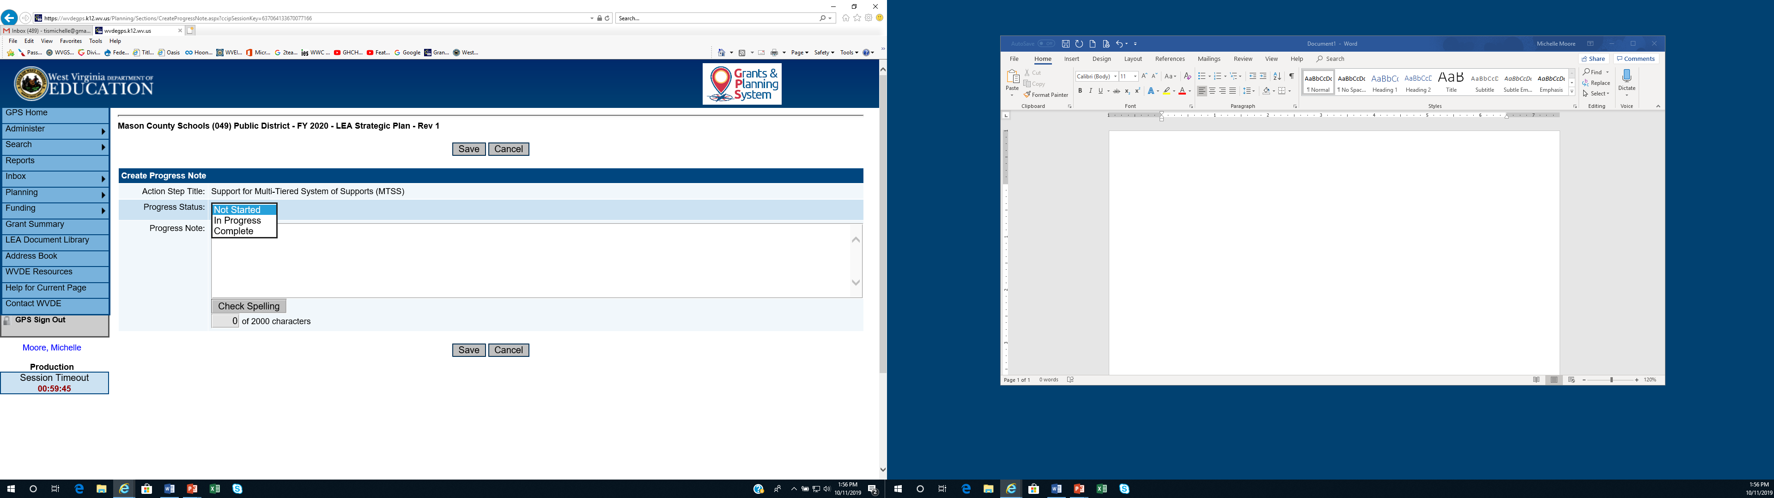
Notes:
During the monitoring phase, data is collected and reviewed to determine the results and completion status of each activity. Monitoring provides vital information of progress outcomes and immediate feedback about adjustments that may be needed.
Progress Notes within GPS are layered and will serve as reference for the team when developing the next plan.
Remember: What gets monitored gets done!

Slide 33
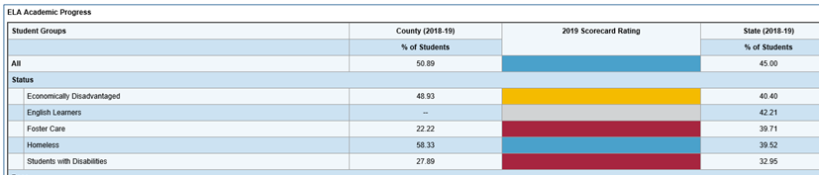
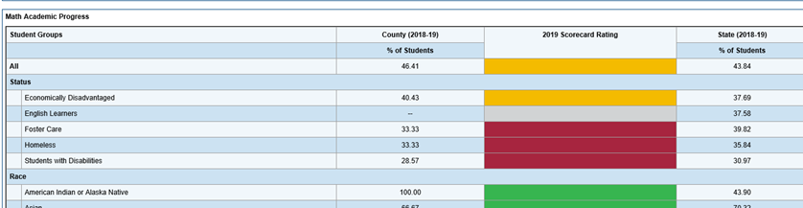
GPS Updates
ELA Progress and Math Progress Data tables have been added, w/Balanced Scorecard colors

Slide 34
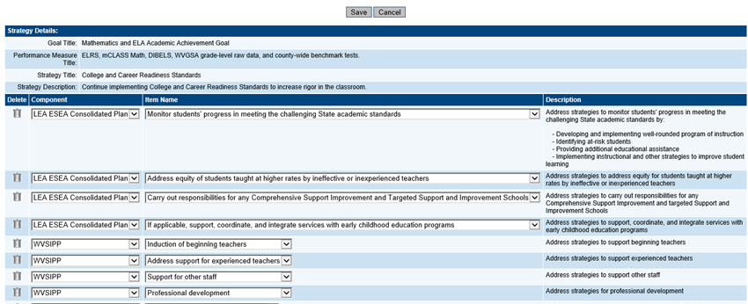
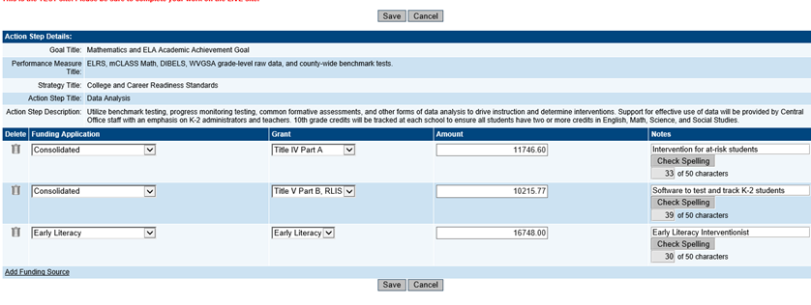
GPS Updates
Can select multiple Component Relationships and Funding Sources, in the respective windows

Slide 35
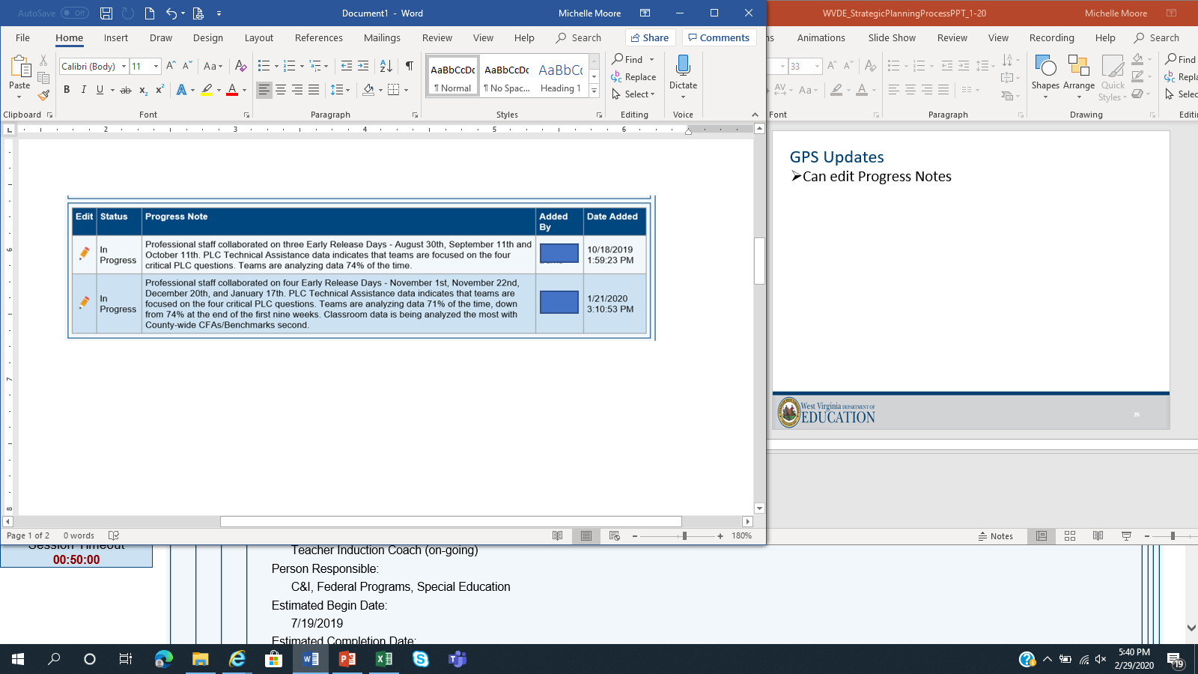
GPS Updates
Can edit Progress Notes

Slide 36
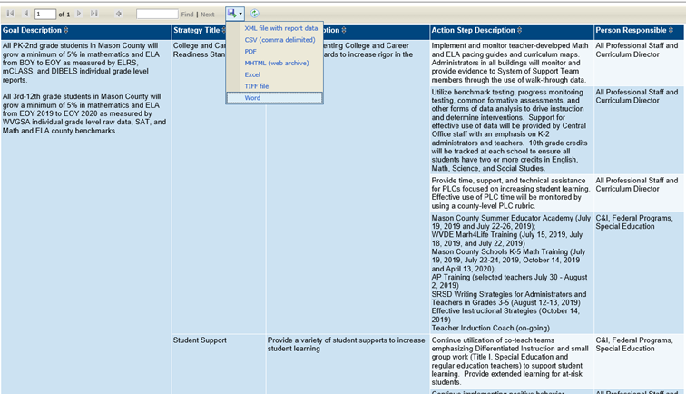
GPS Updates
Alternate Views will now print streamlined copies of the strategic plan, including option to print Progress Notes
Click drop down arrow to select option

Slide 37
Let’s log in and take a look at the GPS platform! https://wvdegps.k12.wv.us
Entrance to the platform requires Webtop credentials (Office 365 login) and access approval.
Remember:
Notes:
Be sure to move the plan into “Plan Started”.
The last year’s plan will pre-populate into the next school year.

Slide 38
Resources
Four Domains for Rapid School Improvement
Center on School Turnaround
http://centeronschoolturnaround.org/wp-content/uploads/2017/02/CST_Four-Domains-Framework-Final.pdf
Using Needs Assessments for School and District Improvement: A Tactical Guide
Council of Chief State School Officers and Center on School Turnaround
http://centeronschoolturnaround.org/wp-content/uploads/2017/05/NeedsAssessment-Final.pdf
Understanding Federally Required Education Policy Needs Assessments and Maximizing Their Impact
Council of Chief State School Officers
https://www.ccsso.org/resource-library/understanding-federally-required-education-policy-needs-assessments-and-maximizing

Slide 39
Resources
Needs Assessment Guidebook: Supporting the Development of District and School Needs Assessments
State Support Network https://statesupportnetwork.ed.gov/system/files/needsassessmentguidebook-508_003.pdf
A District Guide to ESSA and the Importance of Stakeholder Engagement
Partners for Each and Every Child
http://www.partnersforeachandeverychild.org/Publications/P4_District%20Guide_12.11.16.pdf
Data Logic Chain Activity
Based on Using Data to Guide Action for School Improvement (2012) from the Nebraska Department of Education (NDE), Education Service Unit #1, and the North Central Comprehensive Center at McREL (available at https://files.eric.ed.gov/fulltext/ED565721.pdf, with more information from NDE at https://www.education.ne.gov/apac/school-improvement/).

Slide 40

Michelle Moore Leftwich, mmoore@k12.wv.us
WVDE Office of Federal Programs
304.558.7805

