Slide 1
Progress Monitoring the Strategic Plan
Notes:
Set the stage for the day.
Explain purpose/outcomes for the day.

Slide 2
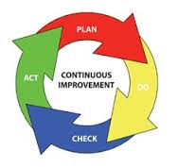
Continuous Improvement
Notes:
During the monitoring phase, data is collected and reviewed to determine the results and completion status of each activity. Monitoring provides vital information of progress outcomes and immediate feedback about adjustments that may be needed.

Slide 3

Monitor, often
Once the plan has been approved, move the status to
‘Progress Monitoring’
Identify a monitoring system for the plan, (this should occur prior to plan implementation.
Schedule consistent times to review and update the plan (bi-monthly, each grade period, three times per year, etc.).
Determine who is responsible for gathering progress data and method of reviewing it with the team. Consider creating a data dashboard.
Notes:
“Monitor and adjust, monitor and adjust” Lezotte and Synder, What Effective Schools Do

Slide 4
Data Dashboard would include multiple data results; organized and presented in an easy to read/useful format for stakeholders to interpret.

Slide 5
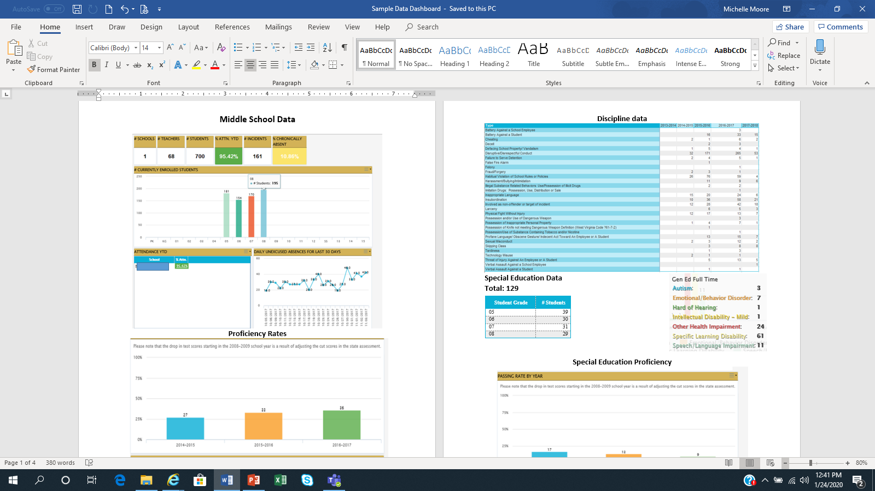
Data Dashboard would include multiple data results; organized and presented in an easy to read/useful format for stakeholders to interpret.

Slide 6
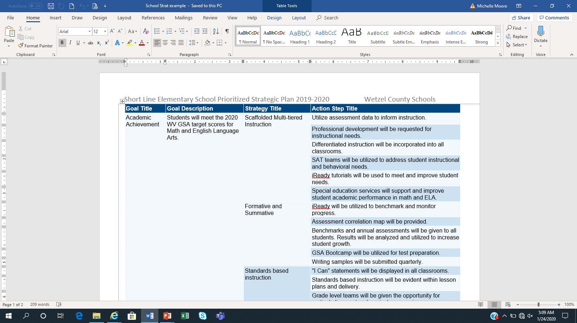
Progress Monitoring at the Action Step Level

Slide 7
Monitor, often
During the review meeting,
--Assess how well the strategies and action steps are being implemented and what impact those may be having,
--Examine the outcomes to determine the extent the strategies helped achieve the set goals,
--Use that information to determine the next round of discussions and strategy-setting for improvement.
Notes:
“Monitor and adjust, monitor and adjust” Lezotte and Synder, What Effective Schools Do

Slide 8
Data Informed Decision Making
What do we want to know (the progress)? Additional probing questions may be needed and useful.
What data is relevant to review for the strategy/action step(s)? A variety of data may be needed to answer the probing questions.
What skills and tools do we need to analyze the data? Compare and contrast several different sources about the same topic to evaluate the data and develop conclusions.
What does the data tell us? What are the reasons we are seeing these results? Consider contributing factors that are within our control and influence.
What other data do we need to help verify or confirm our conclusions?
Adapted from the Forum Guide to Taking Action with Education Data (2012) from the National Forum on Education Statistics at NCES (available at https://nces.ed.gov/forum.pub.2013801.asp)
Notes:
Avoid forming conclusions on only one piece of information. Be sure to tailor the data to meet the needs to thoroughly answering the questions.
PM (Performance Measure tools)

Slide 9
In a Nutshell…
What do the data results look like?
Why does the data look the way that it does?
What strategies, practices, resources are working or not working? Why?
From the determined conclusions, what will be the next step(s)?
Repeat this same analysis process for each action step in the strategic plan.

Slide 10
Monitor, often
Document results
--Progress notes should include relevant information to show the specific data results, explanations, and next steps related to the activity.
--These notes will remind the team of progress and any continued needs.
Notes:
Thorough progress notes will guide the development of the next plan’s comprehensive needs assessment. Then the planning process cycle continues.

Slide 11
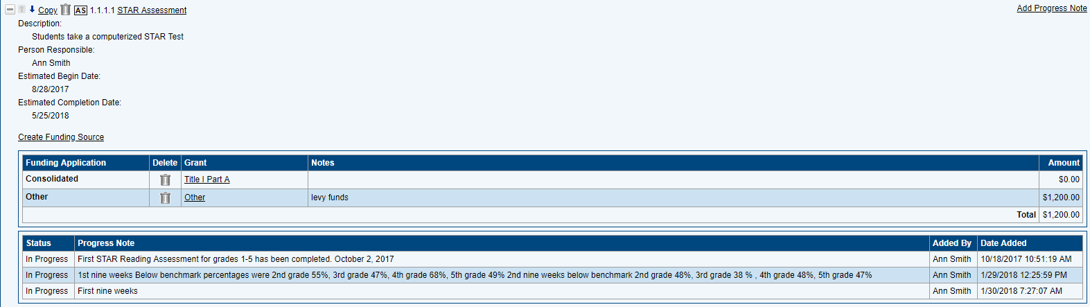
Progress Notes within the System
Notes:
Progress Notes within GPS are layered and will serve as reference for the team when developing the next plan.
Remember: What gets monitored gets done!

Slide 12
Let’s log in and take a look at the GPS platform! https://wvdegps.k12.wv.us
Access to this platform requires Webtop credentials (Office 365 login) and Plan Entry Level approval.
Remember:
Notes:
WVDE Resources are on the homepage of the GPS platform.

Slide 13


Slide 14

Michelle Moore Leftwich, mmoore@k12.wv.us
WVDE Office of Federal Programs
304.558.7805
Notes:
Remind that they can print a user-friendly copy of the plan. A step-by-step video guide is under WVDE Resources.

