Slide 1
Tips for Purposeful Planning:
Connecting School Counseling & School Strategic Planning presented by Michelle Leftwich, WVDE Coordinator

Slide 2

Learning Objectives
Participants will
identify the various steps in the strategic planning process.
determine relevant data to inform the school needs assessment.
understand strategies for data collection, analysis, and setting priorities.
connect the role of school counselors in the school strategic planning process.
determine the relationship of the annual student impact goal to the priorities identified in the school strategic plan and comprehensive school counseling plan.

Slide 3
WV Standards for Effective Schools
Clear and Focused Mission
Instructional Leadership
High Expectations for Success
Positive and Safe Environment
Equitable Opportunities to Learn and Effective Instruction
Frequent Monitoring of Student Progress
Family and Community Partnerships

Slide 4
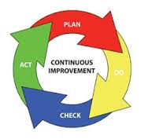
Continuous Improvement
Notes:
The WV strategic planning process is reflective of the WV Standards for Effective Schools.

Slide 5
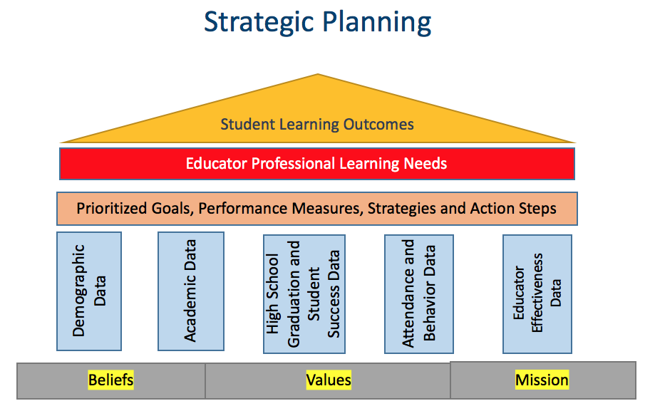
WV Strategic Plan
Planning Process
Comprehensive Support and Improvement & Targeted Support and Improvement Plans
Needs Assessment
Goals
Performance Measures
Progress Notes
Strategies
Action Steps
ESEA Components: District/Title I Schoolwide/TAS
GPS Houses the Plan
Notes:
ESEA required components
CSI school improvement plan

Slide 6

Tip #1 Look at the current plan
Information from the school’s current plan (action step progress) informs the needs assessment for the next plan.
This Photo by Unknown Author is licensed under CC BY-SA-NC

Slide 7
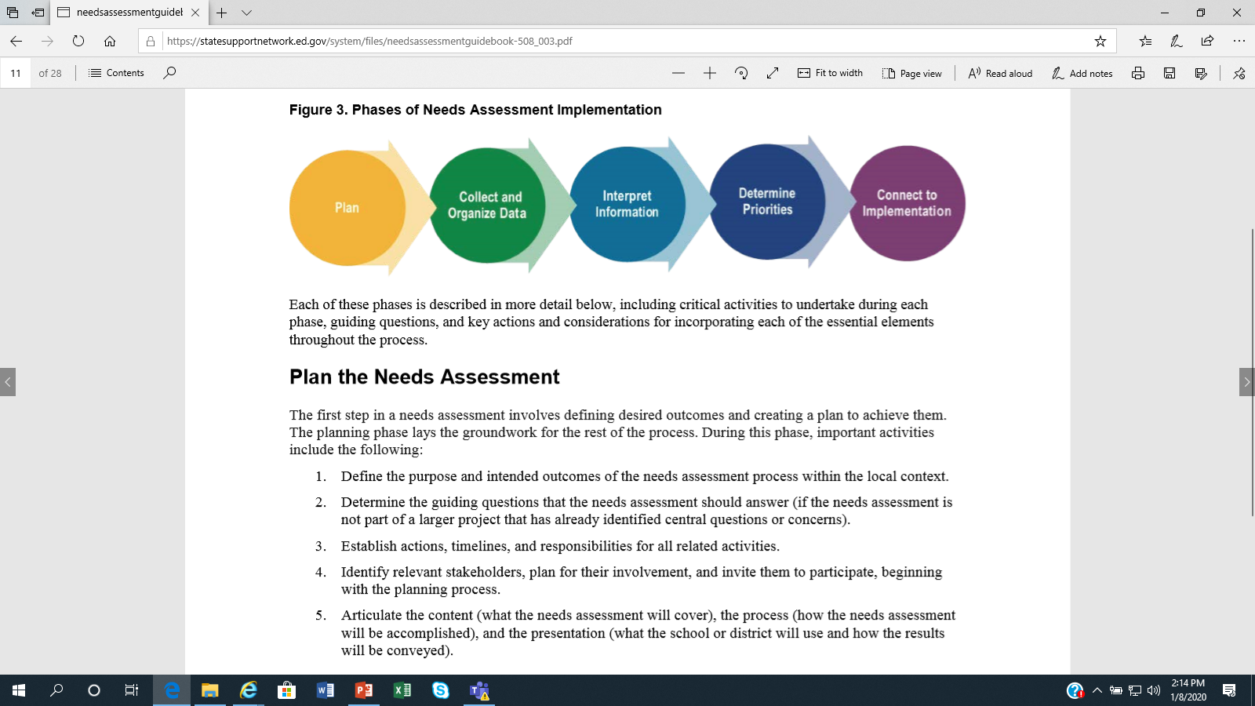
Tip #2 The Needs Assessment Drives the Plan
What is the framework? Who will be involved?
What various forms of data will be collected? How will it be organized and presented?
Why does the data look the way that it does (root cause)?
How will the focus be narrowed into a manageable, key set of priorities?
What evidence-based strategies/
interventions will support long-term change?
State Support Network, Needs Assessment Guidebook, pg. 8, May 2018
Notes:
Comprehensive Needs Assessment definition: What is it? An attempt to assess or measure a perceived or actual need by collecting data (from various sources) to document a challenge that exists
Data sources (evidence) also result from practices, strategies, and interventions provided…Remember to maintain data on funding activities, such as support staffing from Title I/School Improvement/CIS funds, purchased programs, and supplemental resources; blended funding activities, and state/local initiatives.
1) Plan:
--What is the framework of the needs assessment? Demographics, Academics (ELA, Math, ELs), High School/Student Success, Attendance/Behavior, Educator Effectiveness; What do we need to know or understand about each of these topics (instruction, assessment, achievement, climate, etc.)
--Who are the key stakeholders who need to be engaged and at what points in the process? Different stakeholders may be engaged at different levels during the process; be intentional and transparent regarding communication
--Establish actions, timelines, and responsibilities for all related activities
Source: State Support Network: Partnering for School Improvement, Needs Assessment Guidebook, Cary Cuiccio & Marie Husby-Slater, May 2018.

Slide 8

Tip #3 Work as a TRUE team
Developing the plan is not a “solo” assignment.
Identify key stakeholders who are needed for the planning team.
Be sure everyone understands the planning process and their role on the team.
Structure the planning work and hold true to the process.
Notes:
The Comprehensive School Counseling Plan also includes a team, comprised of the same types of stakeholders as the school strategic planning team. Are representatives shared between both of these teams? Are they able to share information/progress results between to the two teams to connect the work?
On the school counseling plan, it indicates a meeting schedule and the role the support team plays in implementing/monitoring the plan. This is the same expectation for the a schoolwide improvement plan (strategic plan).

Slide 9
How are the Strategic Plan Needs Assessment and the School Counseling Plan Needs Assessment Related?
School Strategic Plan Needs Assessment | School Counseling Program Audit | Which Assessment?
Demographic Data | Program Goals, WVCCRDSS, Use of Data, Personalized Student Planning, Data Analysis and Results, Evaluation and Program Improvement | Both
Academic Data | Program Goals, WVCCRDSS, Use of Data, Personalized Student Planning, Data Analysis and Results, Evaluation and Program Improvement | Both
High School Graduation and Student Success Data | Program Goals, WVCCRDSS, Use of Data, Personalized Student Planning, Data Analysis and Results, Evaluation and Program Improvement | Both
Attendance and Behavior Data | Program Goals, WVCCRDSS, Use of Data, Personalized Student Planning, Data Analysis and Results, Evaluation and Program Improvement | Both
Educator Effectiveness Data | Program Goals, School Counselor Evaluation, Program Evaluation | Both
Notes:
The district/school is strongly encouraged to use various data sources to identify strengths and weaknesses across all areas, in order to get a thorough picture of performance, obstacles, and priority needs. For the school counseling program, this information guides the work of the school counselor in developing program improvement goals to strengthen student and school outcomes. These data results and prioritized needs are shared between school counselors, administrators, school strategic planning team and advisory councils, both at the end of the year to share progress toward goal attainment (to develop the plan for next year) and at the beginning of the year to review current priorities and needed supports to achieve goals. It is critical for the school strategic planning process and the school counseling program plan be aligned and a collaborative process.

Slide 10
Tip #4 Collect and Organize Data
What is the framework? Who will be involved?
What various forms of data will be collected? How will it be organized and presented?
Why does the data look the way that it does (root cause)?
How will the focus be narrowed into a manageable, key set of priorities?
What evidence-based strategies/
interventions will support long-term change?
State Support Network, Needs Assessment Guidebook, pg. 8, May 2018
Notes:
2) Collect and Organize Data:
--Needs to be readable and useful for stakeholders.
--Collect and review various forms of relevant data sources; organized and presented for interpretation (See Examples of Additional Data Sources handout); The current strategic plan progress is a data consideration as well as the current WV Balanced Scorecard.
--Identify comparisons within the data sets.
--Disaggregate data wherever possible to help identify areas of need that may not be apparent: (demographics, exceptional students—which includes low-achieving students, students with additional needs—students in foster care, homeless, migratory, English language learners, etc.).
--Aggregate observation data by grade level or grade band and perception data by stakeholder group.
--Include longitudinal data (when possible) to aid in identifying any trends over time.
--Create visuals (charts, tables, graphs) to help understand the information presented; display data in formats that are easy to interpret and analyze.

Slide 11
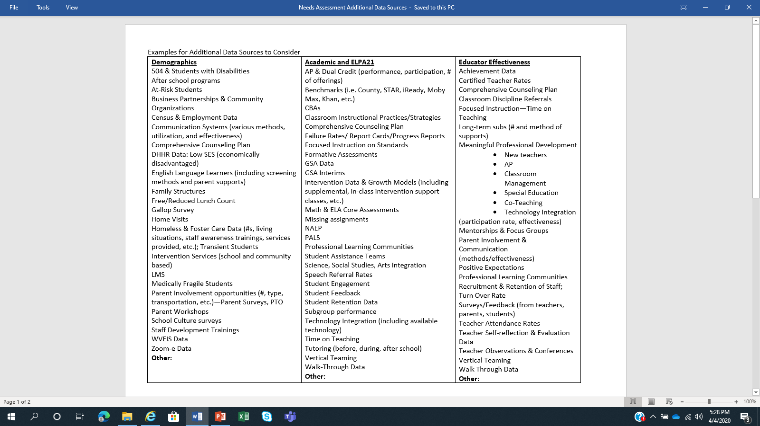

Slide 12
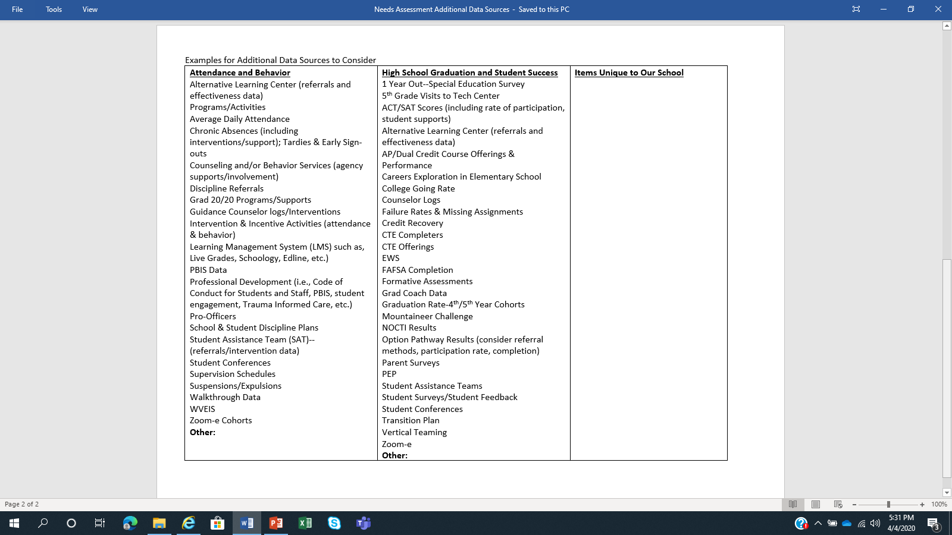

Slide 13
Additional Items Captured by the School Counseling Program
Level of Parent/Family Engagement
Stakeholder Information and Participation
Small group/large group delivery of student success standards
PEPs
Assist with referral and identification of at-risk students
System of Support (in relation to academic, career, and personal/social development)
School crisis responsive services
Notes:
Refer to the Additional Data Sources examples on the WVDE GPS platform, https://wvdegps.k12.wv.us/

Slide 14
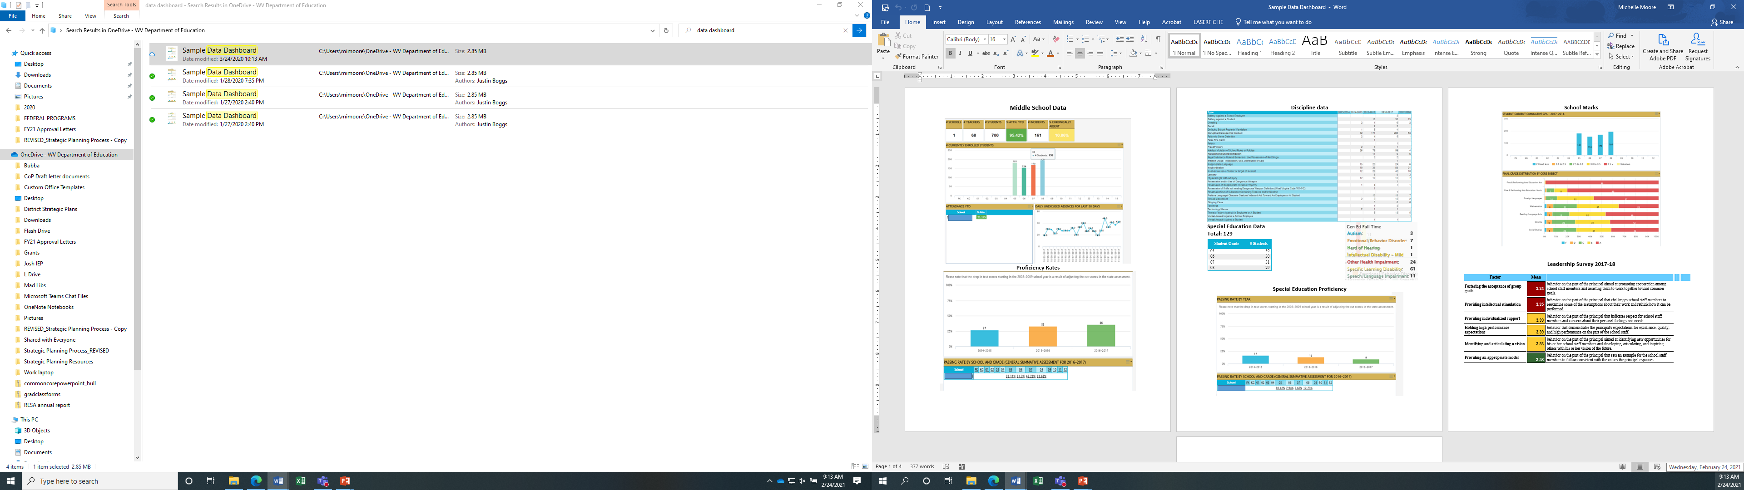

Slide 15
Tip #5 Identify and Explain the Cause
What is the framework? Who will be involved?
What various forms of data will be collected? How will it be organized and presented?
Why does the data look the way that it does (root cause)?
How will the focus be narrowed into a manageable, key set of priorities?
What evidence-based strategies/
interventions will support long-term change?
State Support Network, Needs Assessment Guidebook, pg. 8, May 2018
Notes:
3) Interpret Information:
--Root causes: Examine the relevant data and create meaningful determinations about what is revealed from the data. (Why does the data look the way that it does?); examples… adjustments to teacher instruction or supports for improving attendance, etc.

Slide 16


Area of Concern
How has the concern been addressed?
What’s not working?
What’s working?
Why?
Why?
What adjustments/ changes are needed?
How is funding utilized?
What data supports this information?

Slide 17
Tip #6 Narrow the Focus
What is the framework? Who will be involved?
What various forms of data will be collected? How will it be organized and presented?
Why does the data look the way that it does (root cause)?
How will the focus be narrowed into a manageable, key set of priorities?
What evidence-based strategies/
interventions will support long-term change?
State Support Network, Needs Assessment Guidebook, pg. 8, May 2018
Notes:
4) Determine Priorities:
--Multiple needs or issues may emerge…it is important to narrow this list to a key set of priorities that are manageable.
Various tools are available online to assist with determining priorities.
Simple approaches—rank ordering the needs without any particular formal procedure
Multiple criteria approach—for more complex needs that are judged against criteria that address importance and feasibility
Risk assessment—done by examination of the needs relative to the risk of not addressing them
--Address the strategies and resources (especially federal, state, local funded)that have been implemented and reflected in the data. (What’s working or not working and why?);

Slide 18

Narrow the Focus
Areas of Concern
Low math performance (especially with Low SES and Special Education students)
Poor reading skills (ninth grade students and minority students)
High # chronic absences
Low family involvement
Low student participation (in class & extracurricular)
Inconsistent classroom instruction
Classroom management
Excessive behavior referrals
Increase of students in ISS
Identified Priorities
Increase reading and math performance
Improve intervention strategies with at-risk student groups
Improve school culture and climate
Example
Example
This Photo by Unknown Author is licensed under CC BY
Notes:
From the schoolwide CNA, what are the key priorities to focus on for the upcoming school year? What role does the school counselor play in supporting these? This information can support the analysis of the school counseling program and development of the school counseling program goals.
Both the Comprehensive School Counseling Plan and School Strategic Plan should reflect a clear connection in strategies, supports, and activities.

Slide 19
Tip #7 Connect the Needs to the Actions
What is the framework? Who will be involved?
What various forms of data will be collected? How will it be organized and presented?
Why does the data look the way that it does (root cause)?
How will the focus be narrowed into a manageable, key set of priorities?
What evidence-based strategies/
interventions will support long-term change?
State Support Network, Needs Assessment Guidebook, pg. 8, May 2018
Notes:
5) Connect with Implementation:
--Identify, examine, and select appropriate strategies and evidence-based interventions for implementation that will support long-term change.
--Revisit the strategic plan to make adjustments, based on the identified needs; develop goals, implementation strategies, and activities (action steps) to support the needs.
Source: State Support Network: Partnering for School Improvement, Needs Assessment Guidebook, Cary Cuiccio & Marie Husby-Slater, May 2018.
Remember: The consolidated funding application and strategic plan activities must tie back to the comprehensive needs assessment.

Slide 20
Available, online, resources for evidence-based interventions:
What Works Clearing House https://ies.ed.gov/ncee/wwc/
-- includes various, available programs and shows the evidence of effectiveness
State Support Network https://tinyurl.com/SI-evidencebased
-- leveraging evidence-based practices for local school improvement
Blueprints For Healthy Youth Development https://www.blueprintsprograms.org/
-- a national violence prevention initiative to identify programs that are effective in reducing adolescent violent crime, aggression, delinquency, and substance abuse.

Slide 21
Tip #8 Develop priority focused goals
The priority areas are determined from the needs assessment.
Create SMART goals (Specific, Measurable, Attainable, Relevant, and Time Sensitive)
Some goals may take time (two or three years) to achieve. Make adjustments, guided by the data/feedback results.

Slide 22
Example
Goal: By June 6, 2022, there will be a 10% decrease in student suspensions (combined in-school and out-of-school).
Progress Measures: ZoomWV-e data, intervention data, SAT referrals/interventions, family engagement, resource programs, student/staff/family feedback surveys, and school counseling program data

Slide 23
Sample: Establishing an Annual School-wide Goal
School Strategic Plan Goal
By June 6, 2022 there will be a 10% decrease in student suspensions (combined in-school and out-of-school).
Groups Working on Goal
Communities In
Schools
School Counselor(s)
Teachers
Meet with 100% of students who have been suspended, post-suspension.
95% of teachers participate in Trauma-informed Practices series of trainings offered by school.
Identify students who were suspended in prior school year and case manage 100% of students who had 2 or more suspensions.
Group Specific Sub Goals
Group Specific Aligned Activities
One-on-one counseling
Small groups on specific topics (e.g., anger management)
Participate in training
Implement practices learned in training in the classroom
Case manage 25+ students (between 5-10% of school population)
Implement tiered supports to help improve behavior focused on root causes of behavior issues

Slide 24
Sample: Student Impact Goal
School Strategic Plan Goal
By June 6, 2022 there will be a 10% decrease in student suspensions (combined in-school and out-of-school).
Student Impact Goals
By May 2022, 80% of students who were suspended will identify and clearly articulate techniques for self-management and positive decision making.
Aligned Activity
One-on-one counseling
Small groups on specific topics (e.g., anger management)
Progress Measure
Pre & Post assessment
Student self-reflection/survey
School discipline data

Slide 25
Tip #9 Incorporate evidence-based strategies
Select rigorous and relevant resources that will best meet the identified priorities.
Ensure interventions are supported by strong, moderate, or promising evidence (avoid gut feelings or solely based on “suggestions”).
Be sure there is local capacity to implement the interventions successfully (available funding, staff resources, staff skills, and support for the interventions).

Slide 26

Tip #10 Action Steps
Be specific about what activities will occur.
Decide who will be the person(s) responsible for implementing and monitoring the action step(s).
Determine what process and data will be used to monitor the effectiveness of each action step.
Notes:
Action Steps: implementation of the strategy

Slide 27

Tip #11 Monitor, often
Prior to plan implementation, schedule consistent times to review and update the plan (bi-monthly, each grade period, three times per year, etc.).
Determine who is responsible for gathering the strategic plan’s progress data and method of reviewing/presenting it to the team. Consider creating a data dashboard.
Notes:
“Monitor and adjust, monitor and adjust” Lezotte and Synder, What Effective Schools Do

Slide 28

During the review meeting:
Assess and discuss how well the strategies and action steps are being implemented. What impact is evident?
Examine the outcomes to determine the extent to which the strategies helped achieve the set goals. Why does the data look the way it does?
Document the results, root cause analysis, and any adjustments that are needed.

Slide 29
Tip #12 Build it outside of GPS
It is Highly Recommended to draft the plan on a digital template before entering into GPS.
Anyone on the team, with GPS access, can enter (type) the information into the platform.
Notes:
-Develop the draft of the plan before entering it into GPS
-Review the draft plan with staff, student leadership, LSIC, etc.
-Make final edits to the draft plan then enter the plan into the GPS platform. (Note: Designated individuals can be given Plan entry level access to the GPS plan. Contact your district superintendent’s office to obtain access. The GPS login is accessible with your Office 365 credentials.); Work with district leadership to work in conjunction with district focus areas/initiatives.
-Decide a progress monitoring timeline to review the plan (ex. Monthly, bi-monthly, each semester, etc.)
--input progress notes/data reviews into narrative (maintain as a diary)
--tweak/update goals and action steps as needed
-Use this progress information to guide next years plan

Slide 30
Purposeful Planning = Continuous Improvement
Notes:
What gets monitored, gets done!

Slide 31
Resources
Needs Assessment Guidebook: Supporting the Development of District and School Needs Assessments
State Support Network https://statesupportnetwork.ed.gov/system/files/needsassessmentguidebook-508_003.pdf
A District Guide to ESSA and the Importance of Stakeholder Engagement
Partners for Each and Every Child
http://www.partnersforeachandeverychild.org/Publications/P4_District%20Guide_12.11.16.pdf
WVDE GPS Platform (WVDE Resources)
Strategic planning tool resources are available, which includes templates, guides, video tutorials, and links to past webinars.
https://wvdegps.k12.wv.us/DocumentLibrary/Default.aspx?ccipSessionKey=637497076170380754

Slide 32
Video Resources
Part I Strategic Planning Process
Part II Comprehensive Needs Assessment
Part III Goals, Strategies, Action Steps
Part IV Progress Monitoring the Plan

Slide 33

Michelle Moore Leftwich, mmoore@k12.wv.us
WVDE Office of Federal Programs
304.558.7805

